Slide 1
Vocabulary
Red Hot Root Words

Slide 2
Prefixes
Prefixes Meaning Words You Already Know
Co, col with, together cooperate, collect
Com, con with, together combine, connect
Syn, sym with, together synonym, sympathy
Notes:
Input:
Present the root words” Explain their meanings.
CFU:
Ask students to tell you another word with fore
Repeat with other root words.

Slide 3
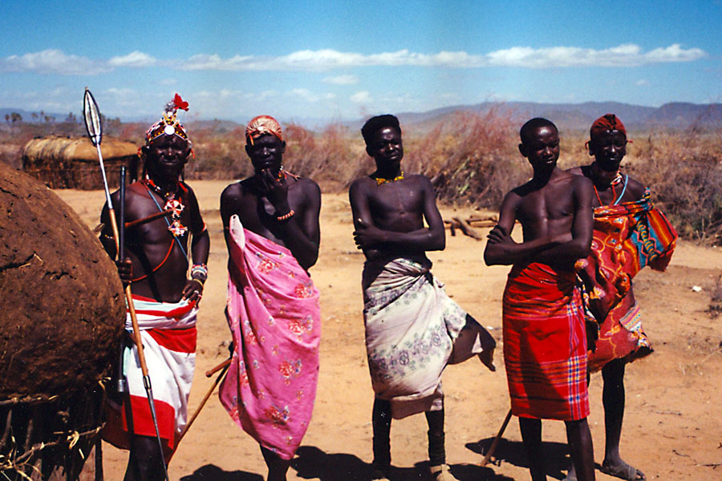
coexist
Verb
To exist at the same time or in the same place
The two tribes coexisted peacefully in the same area for about two hundred years.
Notes:
Input:
Present the word
State the part of speech
Read the definition and sentence
Point out the suffix on the word
Tell students to make sure they are familiar with how the word is used in the sentence
CFU:
Ask a student to give a paraphrase, example, or another sentence
Ask a different student to provide an example or another sentence using the word
Model:
If students are not able to do the CFU, provide a paraphrase and an example
Do this for any word that the students cannot paraphrase or give an example for.

Slide 4
coherent
Adjective
Sticking together; connected, related in some way
Her speech was coherent, each point following logically from the previous point.
Notes:
Input:
For each of the following slides (with vocabulary words) have each student in turn:
Present the word
State the part of speech
Read the definition and sentence
Point out the suffix on the word
CFU:
Ask one of the other students to give a paraphrase of the definition, and another to provide an example or another sentence using the word.
Provide positive verbal feedback for each.
Restate the example or paraphrase if unclear how it relates (informal error correction)

Slide 5
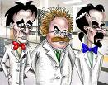
collaborate
Verb
To labor together
The scientists decided to collaborate in their research.
Notes:
Input:
Have students to identify the part of speech, read the definition and the sentence.
Clarify/restate any information that is unclear or inaccurate.
Point out the suffix on the word
CFU:
Ask a student to give a paraphrase of the definition
Ask a different student to provide an example or another sentence using the word

Slide 6
collide
Verb
To come together with great force; to clash
The two football players collided with such force that they both ended up on the ground.
Notes:
Input:
Have students to identify the part of speech, read the definition and the sentence.
Clarify/restate any information that is unclear or inaccurate.
Point out the suffix on the word
CFU:
Ask a student to give a paraphrase of the definition
Ask a different student to provide an example or another sentence using the word

Slide 7
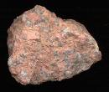
composite
Adjective
Made of separate parts or elements
Granite is a composite rock, made of basalt, quartz, and mica.

Slide 8
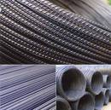
compound
Verb
Bring together; (noun) a mixture
Steel is a compound made of iron and other metals.
Notes:
Input:
Have students to identify the part of speech, read the definition and the sentence.
Clarify/restate any information that is unclear or inaccurate.
Point out the suffix on the word
CFU:
Ask a student to give a paraphrase of the definition
Ask a different student to provide an example or another sentence using the word

Slide 9
Concordance
Noun
An agreement or harmony
The feuding countries reached a concordance that ended their disputes.
Notes:
Input:
Have students to identify the part of speech, read the definition and the sentence.
Clarify/restate any information that is unclear or inaccurate.
Point out the suffix on the word
CFU:
Ask a student to give a paraphrase of the definition
Ask a different student to provide an example or another sentence using the word

Slide 10
Congregate
Verb
To gather together
All the families in the neighborhood congregated for a potluck dinner.
Notes:
Input:
Have students to identify the part of speech, read the definition and the sentence.
Clarify/restate any information that is unclear or inaccurate.
Point out the suffix on the word
CFU:
Ask a student to give a paraphrase of the definition
Ask a different student to provide an example or another sentence using the word

Slide 11
symmetry
Noun
Elements on both sides of a line that have the same shape, size, and arrangement
The design on the butterfly showed perfect symmetry.
Notes:
Input:
Have students to identify the part of speech, read the definition and the sentence.
Clarify/restate any information that is unclear or inaccurate.
Point out the suffix on the word
CFU:
Ask a student to give a paraphrase of the definition
Ask a different student to provide an example or another sentence using the word

Slide 12
synthesize
verb
To form a new thing by combining parts from other things; to unite or merge
The medical researcher synthesized a new drug by blending two existing remedies.
Notes:
Input:
Have students to identify the part of speech, read the definition and the sentence.
Clarify/restate any information that is unclear or inaccurate.
Point out the suffix on the word
CFU:
Ask a student to give a paraphrase of the definition
Ask a different student to provide an example or another sentence using the word

Slide 13
Practice Using the New Words!
Notes:
The independent practice that goes with this lesson will be introduced with this slide. As it is modified, I will not present it on the PPT or SB as that may cause confusion for the students who have the unmodified version. However, the following is how I will review the worksheet with the whole class:
Input:
Read the directions for the first section.
CFU: Ask if there are any questions
Guided Practice/Modeling:
Read the two words listed for the first question.Ask if the two words have the same meaning or different meanings. Model looking up the meaning for construe – note that assume the meaning is part of the definition. Have a student say that the words have the same meaning. Have the students circle same. Tell them they will do the same for 2-8.
CFU: ask if there are questions
Input: read the directions for the second section
Guided Practice: read the word for #9. Explain that they are to determine the meaning of port and then add the meaning of er. Give the example of teach + er…someone who teaches. Say to do the same thing for port, but that someone who ports doesn’t make sense, so they will need to look at the MEANING for port…to carry from one palace to another. A porter is someone who carries things from one place to another. Have students write in answer. Tell them to do the remaining two questions the same way.
CFU ask for questions.
Input: read the directions for the third question.
G.P. Do the first one together. Have three different students name one thing that is portable. Have students write in the answers.
CFU ask for questions
IP: have students complete the worksheet independently. CFU: circulate. Monitor for correct answers. If time allows when students are finished, go over the answers as class.
Closure: Remind students to review the words during the week. Remind them that if they learn the root words they will add more than just those ten words to their vocabulary. Have students turn in worksheets to appropriate areas.

