Slide 1
Vocabulary
Red Hot Root Words

Slide 2
Prefixes
Prefixes Meaning Words You Already Know
e, ec, ef, ex out of, outside emit, eclipse, effort, exit
extra, exter out of, outside, excessive extraterrestrial, exterior
Notes:
Input:
Present the root words” Explain their meanings.
CFU:
Ask students to tell you another word with fore
Repeat with other root words.

Slide 3
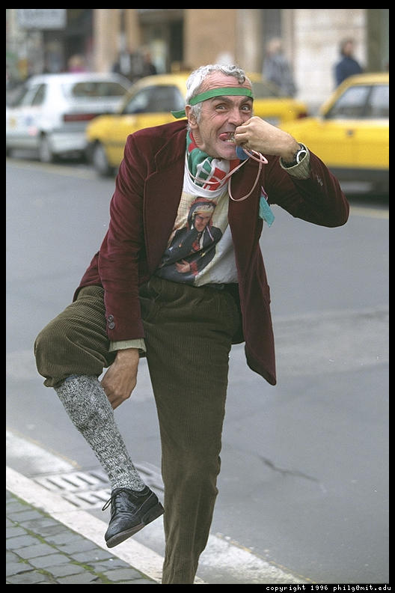
eccentric
adjective
Ignoring social conventions; odd
The eccentric old man lived by himself and had strange habits but didn’t hurt anyone.
Notes:
Input:
Present the word
State the part of speech
Read the definition and sentence
Point out the suffix on the word
Tell students to make sure they are familiar with how the word is used in the sentence
CFU:
Ask a student to give a paraphrase, example, or another sentence
Ask a different student to provide an example or another sentence using the word
Model:
If students are not able to do the CFU, provide a paraphrase and an example
Do this for any word that the students cannot paraphrase or give an example for.

Slide 4
ecstasy
noun
Happiness; overwhelming feelings of joy
She experienced a feeling of ecstasy when it was announced that she was the winner.
Notes:
Input:
For each of the following slides (with vocabulary words) have each student in turn:
Present the word
State the part of speech
Read the definition and sentence
Point out the suffix on the word
CFU:
Ask one of the other students to give a paraphrase of the definition, and another to provide an example or another sentence using the word.
Provide positive verbal feedback for each.
Restate the example or paraphrase if unclear how it relates (informal error correction)

Slide 5
effervesce
verb
To give off bubbles; to show excitement or liveliness
She seemed to effervesce and soon everyone was just as excited as she was.
Notes:
Input:
Have students to identify the part of speech, read the definition and the sentence.
Clarify/restate any information that is unclear or inaccurate.
Point out the suffix on the word
CFU:
Ask a student to give a paraphrase of the definition
Ask a different student to provide an example or another sentence using the word

Slide 6
effusive
Adjective
Demonstrative; unreserved; overflowing; pouring out
Her effusive personality made people doubt the sincerity of her compliments.
Notes:
Input:
Have students to identify the part of speech, read the definition and the sentence.
Clarify/restate any information that is unclear or inaccurate.
Point out the suffix on the word
CFU:
Ask a student to give a paraphrase of the definition
Ask a different student to provide an example or another sentence using the word

Slide 7
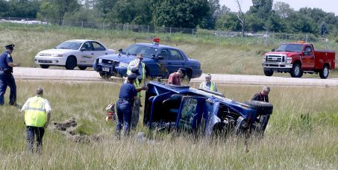
eject
verb
To throw out
Because he was not wearing a seat belt, he was ejected from the car during the accident.

Slide 8
emit
Verb
to send out; discharge
The beacon emitted a strong beam of light every 30 seconds.
Notes:
Input:
Have students to identify the part of speech, read the definition and the sentence.
Clarify/restate any information that is unclear or inaccurate.
Point out the suffix on the word
CFU:
Ask a student to give a paraphrase of the definition
Ask a different student to provide an example or another sentence using the word

Slide 9
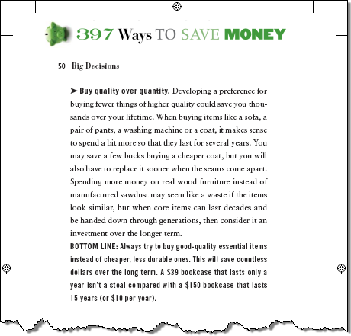
excerpt
noun
A selected passage from a book or article
I enjoyed the excerpt so much that I now want to read the entire book.
Notes:
Input:
Have students to identify the part of speech, read the definition and the sentence.
Clarify/restate any information that is unclear or inaccurate.
Point out the suffix on the word
CFU:
Ask a student to give a paraphrase of the definition
Ask a different student to provide an example or another sentence using the word

Slide 10
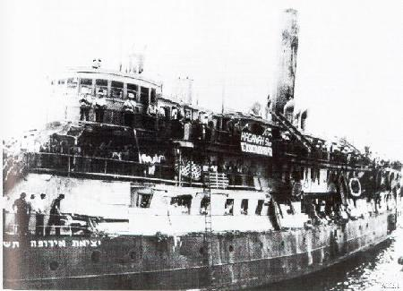
exodus
noun
A departure or journey away from a place
The family’s exodus from their homeland was dangerous and disheartening.
Notes:
Input:
Have students to identify the part of speech, read the definition and the sentence.
Clarify/restate any information that is unclear or inaccurate.
Point out the suffix on the word
CFU:
Ask a student to give a paraphrase of the definition
Ask a different student to provide an example or another sentence using the word

Slide 11
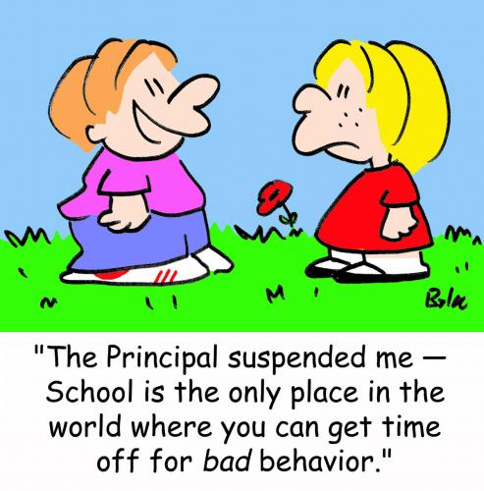
expulsion
Noun
A forcing out
his bad behavior caused his expulsion from the organization.
Notes:
Input:
Have students to identify the part of speech, read the definition and the sentence.
Clarify/restate any information that is unclear or inaccurate.
Point out the suffix on the word
CFU:
Ask a student to give a paraphrase of the definition
Ask a different student to provide an example or another sentence using the word

Slide 12
extrude
Verb
Force or press out
The machine extruded the cereal in the shape of stars and moons.
Notes:
Input:
Have students to identify the part of speech, read the definition and the sentence.
Clarify/restate any information that is unclear or inaccurate.
Point out the suffix on the word
CFU:
Ask a student to give a paraphrase of the definition
Ask a different student to provide an example or another sentence using the word

Slide 13
Practice Using the New Words!
Notes:
The independent practice that goes with this lesson will be introduced with this slide. As it is modified, I will not present it on the PPT or SB as that may cause confusion for the students who have the unmodified version. However, the following is how I will review the worksheet with the whole class:
Input:
Read the directions for the first section.
CFU: Ask if there are any questions
Guided Practice/Modeling:
Read the two words listed for the first question.Ask if the two words have the same meaning or different meanings. Model looking up the meaning for construe – note that assume the meaning is part of the definition. Have a student say that the words have the same meaning. Have the students circle same. Tell them they will do the same for 2-8.
CFU: ask if there are questions
Input: read the directions for the second section
Guided Practice: read the word for #9. Explain that they are to determine the meaning of port and then add the meaning of er. Give the example of teach + er…someone who teaches. Say to do the same thing for port, but that someone who ports doesn’t make sense, so they will need to look at the MEANING for port…to carry from one palace to another. A porter is someone who carries things from one place to another. Have students write in answer. Tell them to do the remaining two questions the same way.
CFU ask for questions.
Input: read the directions for the third question.
G.P. Do the first one together. Have three different students name one thing that is portable. Have students write in the answers.
CFU ask for questions
IP: have students complete the worksheet independently. CFU: circulate. Monitor for correct answers. If time allows when students are finished, go over the answers as class.
Closure: Remind students to review the words during the week. Remind them that if they learn the root words they will add more than just those ten words to their vocabulary. Have students turn in worksheets to appropriate areas.

