Slide 1
Vocabulary
Red Hot Root Words

Slide 2
Prefixes
Prefixes Meaning Words You Already Know
dia through, across diameter, dialogue
per through, across perceive
Notes:
Input:
Present the root words” Explain their meanings.
CFU:
Ask students to tell you another word with fore
Repeat with other root words.

Slide 3
diagram
Noun
A picture drawn to explain an idea
On the test we had to draw a diagram to show how a circuit worked.
Notes:
Input:
Present the word
State the part of speech
Read the definition and sentence
Point out the suffix on the word
Tell students to make sure they are familiar with how the word is used in the sentence
CFU:
Ask a student to give a paraphrase, example, or another sentence
Ask a different student to provide an example or another sentence using the word
Model:
If students are not able to do the CFU, provide a paraphrase and an example
Do this for any word that the students cannot paraphrase or give an example for.

Slide 4
diagnose
verb
To identify a disease through symptoms
The doctor was quickly able to diagnose the child’s disease as measles.
Notes:
Input:
For each of the following slides (with vocabulary words) have each student in turn:
Present the word
State the part of speech
Read the definition and sentence
Point out the suffix on the word
CFU:
Ask one of the other students to give a paraphrase of the definition, and another to provide an example or another sentence using the word.
Provide positive verbal feedback for each.
Restate the example or paraphrase if unclear how it relates (informal error correction)

Slide 5
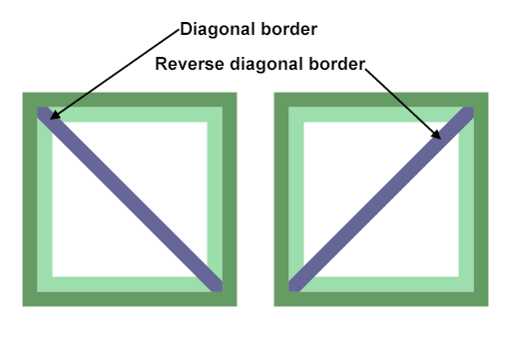
diagonal
noun
A straight line through a figure from one corner to another corner
The diagonal divided the square into two triangles.
Notes:
Input:
Have students to identify the part of speech, read the definition and the sentence.
Clarify/restate any information that is unclear or inaccurate.
Point out the suffix on the word
CFU:
Ask a student to give a paraphrase of the definition
Ask a different student to provide an example or another sentence using the word

Slide 6
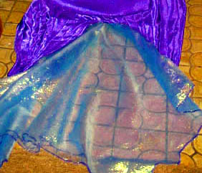
diaphanous
Adjective
Transparent, capable of being seen through
The diaphanous top layer of material revealed a layer of darker material underneath.
Notes:
Input:
Have students to identify the part of speech, read the definition and the sentence.
Clarify/restate any information that is unclear or inaccurate.
Point out the suffix on the word
CFU:
Ask a student to give a paraphrase of the definition
Ask a different student to provide an example or another sentence using the word

Slide 7
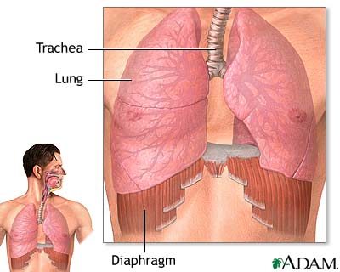
Diaphragm
Noun
A membrane that separates one thing from another, such as the chest cavity and the abdominal cavity
When you breath, your diaphragm moves up and down causing air to flow into and out of the lungs.

Slide 8
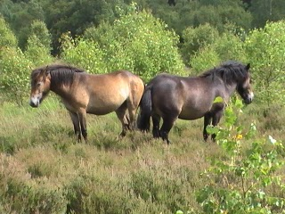
perambulate
verb
To walk through, over or around
The herd perambulated the area, crossing it several times in search of food.
Notes:
Input:
Have students to identify the part of speech, read the definition and the sentence.
Clarify/restate any information that is unclear or inaccurate.
Point out the suffix on the word
CFU:
Ask a student to give a paraphrase of the definition
Ask a different student to provide an example or another sentence using the word

Slide 9
percolate
verb
To drip through a small opening or to filter a liquid
Gradually the rain water percolated through the soil and into the underground cave.
Notes:
Input:
Have students to identify the part of speech, read the definition and the sentence.
Clarify/restate any information that is unclear or inaccurate.
Point out the suffix on the word
CFU:
Ask a student to give a paraphrase of the definition
Ask a different student to provide an example or another sentence using the word

Slide 10
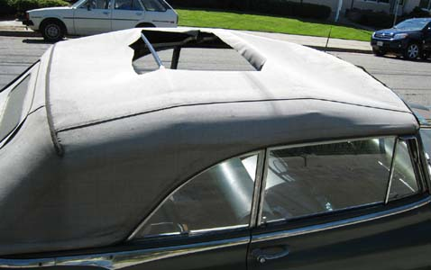
perforate
verb
To make holes in something
If you perforate the convertible’s roof, you’re likely to have rain inside the car.
Notes:
Input:
Have students to identify the part of speech, read the definition and the sentence.
Clarify/restate any information that is unclear or inaccurate.
Point out the suffix on the word
CFU:
Ask a student to give a paraphrase of the definition
Ask a different student to provide an example or another sentence using the word

Slide 11
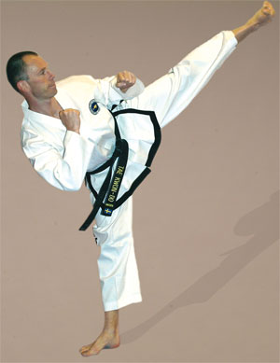
persistence
Noun
Continuing stubbornly without giving up; determination
His persistence finally paid off when he earned his black belt in karate.
Notes:
Input:
Have students to identify the part of speech, read the definition and the sentence.
Clarify/restate any information that is unclear or inaccurate.
Point out the suffix on the word
CFU:
Ask a student to give a paraphrase of the definition
Ask a different student to provide an example or another sentence using the word

Slide 12
pervasive
Adjective
Having the power to be spread or to pass through
The feeling of joy was pervasive, spreading throughout the celebrating group.
Notes:
Input:
Have students to identify the part of speech, read the definition and the sentence.
Clarify/restate any information that is unclear or inaccurate.
Point out the suffix on the word
CFU:
Ask a student to give a paraphrase of the definition
Ask a different student to provide an example or another sentence using the word

Slide 13
Practice Using the New Words!
Notes:
The independent practice that goes with this lesson will be introduced with this slide. As it is modified, I will not present it on the PPT or SB as that may cause confusion for the students who have the unmodified version. However, the following is how I will review the worksheet with the whole class:
Input:
Read the directions for the first section.
CFU: Ask if there are any questions
Guided Practice/Modeling:
Read the two words listed for the first question.Ask if the two words have the same meaning or different meanings. Model looking up the meaning for construe – note that assume the meaning is part of the definition. Have a student say that the words have the same meaning. Have the students circle same. Tell them they will do the same for 2-8.
CFU: ask if there are questions
Input: read the directions for the second section
Guided Practice: read the word for #9. Explain that they are to determine the meaning of port and then add the meaning of er. Give the example of teach + er…someone who teaches. Say to do the same thing for port, but that someone who ports doesn’t make sense, so they will need to look at the MEANING for port…to carry from one palace to another. A porter is someone who carries things from one place to another. Have students write in answer. Tell them to do the remaining two questions the same way.
CFU ask for questions.
Input: read the directions for the third question.
G.P. Do the first one together. Have three different students name one thing that is portable. Have students write in the answers.
CFU ask for questions
IP: have students complete the worksheet independently. CFU: circulate. Monitor for correct answers. If time allows when students are finished, go over the answers as class.
Closure: Remind students to review the words during the week. Remind them that if they learn the root words they will add more than just those ten words to their vocabulary. Have students turn in worksheets to appropriate areas.

