Slide 1
Vocabulary
Red Hot Root Words

Slide 2
Suffixes
Suffixes Meaning Words You Already Know
Ance, ancy state of hesitancy, brilliance
Ence, ency state of residence
Ity state of ability
Ship state of hardship
Notes:
Input:
Present the root words” Explain their meanings.
CFU:
Ask students to tell you another word with fore
Repeat with other root words.

Slide 3
absurdity
Noun
The state of being ridiculously unreasonable or nonsensical
We all laughed at the absurdity of seeing the principal kiss a pig.
Notes:
Input:
Present the word
State the part of speech
Read the definition and sentence
Point out the suffix on the word
Tell students to make sure they are familiar with how the word is used in the sentence
CFU:
Ask a student to give a paraphrase, example, or another sentence
Ask a different student to provide an example or another sentence using the word
Model:
If students are not able to do the CFU, provide a paraphrase and an example
Do this for any word that the students cannot paraphrase or give an example for.

Slide 4
acuity
Noun
Sharpness, especially referring to vision
Few birds have the acuity of a hawk.
Notes:
Input:
For each of the following slides (with vocabulary words) have each student in turn:
Present the word
State the part of speech
Read the definition and sentence
Point out the suffix on the word
CFU:
Ask one of the other students to give a paraphrase of the definition, and another to provide an example or another sentence using the word.
Provide positive verbal feedback for each.
Restate the example or paraphrase if unclear how it relates (informal error correction)

Slide 5
competence
Noun
The state of being capable or fit
Her competence in her field was the reason she was promoted.
Notes:
Input:
Have students to identify the part of speech, read the definition and the sentence.
Clarify/restate any information that is unclear or inaccurate.
Point out the suffix on the word
CFU:
Ask a student to give a paraphrase of the definition
Ask a different student to provide an example or another sentence using the word

Slide 6
complacency
Noun
The state of being pleased or content with oneself; smugness
Her complacency irked her mother, who wanted her daughter to always strive to do better.
Notes:
Input:
Have students to identify the part of speech, read the definition and the sentence.
Clarify/restate any information that is unclear or inaccurate.
Point out the suffix on the word
CFU:
Ask a student to give a paraphrase of the definition
Ask a different student to provide an example or another sentence using the word

Slide 7
fatality
Noun
A fixed, unalterable course of events; an event resulting in death
The traffic fatality was the result of an intoxicated driver losing control of his car.

Slide 8
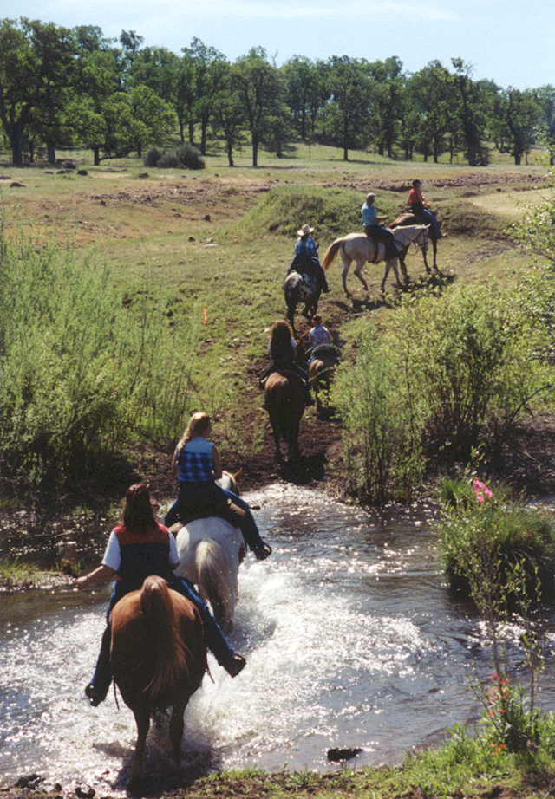
fellowship
Noun
An association with friends or other people with common interests
Darcy enjoyed the fellowship of the other horseback riders.
Notes:
Input:
Have students to identify the part of speech, read the definition and the sentence.
Clarify/restate any information that is unclear or inaccurate.
Point out the suffix on the word
CFU:
Ask a student to give a paraphrase of the definition
Ask a different student to provide an example or another sentence using the word

Slide 9
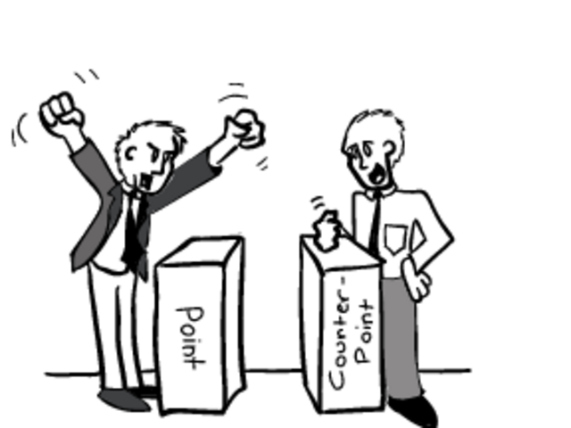
relevancy
Noun
The state of being suitable or relating to the case at hand
I don’t see the relevancy of your argument. It doesn’t relate to what we are discussing.
Notes:
Input:
Have students to identify the part of speech, read the definition and the sentence.
Clarify/restate any information that is unclear or inaccurate.
Point out the suffix on the word
CFU:
Ask a student to give a paraphrase of the definition
Ask a different student to provide an example or another sentence using the word

Slide 10
reluctance
Noun
Unwillingness; not wanting to do something or agree with something
James expressed reluctance to try out for the class play.
Notes:
Input:
Have students to identify the part of speech, read the definition and the sentence.
Clarify/restate any information that is unclear or inaccurate.
Point out the suffix on the word
CFU:
Ask a student to give a paraphrase of the definition
Ask a different student to provide an example or another sentence using the word

Slide 11
sanctity
Noun
The state of being sacred; holiness
Speak quietly when you enter the church so you don’t disturb the sanctity of the building.
Notes:
Input:
Have students to identify the part of speech, read the definition and the sentence.
Clarify/restate any information that is unclear or inaccurate.
Point out the suffix on the word
CFU:
Ask a student to give a paraphrase of the definition
Ask a different student to provide an example or another sentence using the word

Slide 12
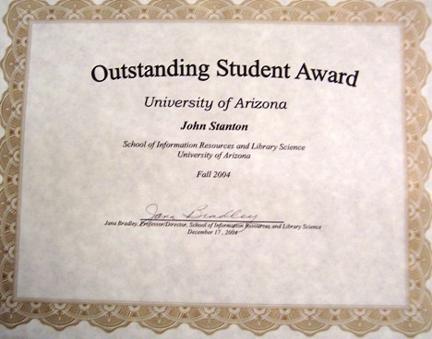
scholarship
Noun
The quality of work done by a student; academic achievement
Peter’s scholarship was recognized with a medal and a certificate at the awards assembly.
Notes:
Input:
Have students to identify the part of speech, read the definition and the sentence.
Clarify/restate any information that is unclear or inaccurate.
Point out the suffix on the word
CFU:
Ask a student to give a paraphrase of the definition
Ask a different student to provide an example or another sentence using the word

Slide 13
Practice Using the New Words!
Notes:
The independent practice that goes with this lesson will be introduced with this slide. As it is modified, I will not present it on the PPT or SB as that may cause confusion for the students who have the unmodified version. However, the following is how I will review the worksheet with the whole class:
Input:
Read the directions for the first section.
CFU: Ask if there are any questions
Guided Practice/Modeling:
Read the two words listed for the first question.Ask if the two words have the same meaning or different meanings. Model looking up the meaning for construe – note that assume the meaning is part of the definition. Have a student say that the words have the same meaning. Have the students circle same. Tell them they will do the same for 2-8.
CFU: ask if there are questions
Input: read the directions for the second section
Guided Practice: read the word for #9. Explain that they are to determine the meaning of port and then add the meaning of er. Give the example of teach + er…someone who teaches. Say to do the same thing for port, but that someone who ports doesn’t make sense, so they will need to look at the MEANING for port…to carry from one palace to another. A porter is someone who carries things from one place to another. Have students write in answer. Tell them to do the remaining two questions the same way.
CFU ask for questions.
Input: read the directions for the third question.
G.P. Do the first one together. Have three different students name one thing that is portable. Have students write in the answers.
CFU ask for questions
IP: have students complete the worksheet independently. CFU: circulate. Monitor for correct answers. If time allows when students are finished, go over the answers as class.
Closure: Remind students to review the words during the week. Remind them that if they learn the root words they will add more than just those ten words to their vocabulary. Have students turn in worksheets to appropriate areas.

