Slide 1
Vocabulary
Red Hot Root Words

Slide 2
Suffixes
Suffixes Meaning Words You Already Know
ment quality of, state of contentment
ness state of loneliness
tion,sion state of, act of celebration
Notes:
Input:
Present the root words” Explain their meanings.
CFU:
Ask students to tell you another word with fore
Repeat with other root words.

Slide 3
amendment
Noun
A change for the better; a correction; an improvement
The amendment to the constitution corrected problems with the original document.
Notes:
Input:
Present the word
State the part of speech
Read the definition and sentence
Point out the suffix on the word
Tell students to make sure they are familiar with how the word is used in the sentence
CFU:
Ask a student to give a paraphrase, example, or another sentence
Ask a different student to provide an example or another sentence using the word
Model:
If students are not able to do the CFU, provide a paraphrase and an example
Do this for any word that the students cannot paraphrase or give an example for.

Slide 4
bereavement
Noun
The state of losing a friend or relative by death; deprivation; loss
Her bereavement after her husband’s death left her depressed.
Notes:
Input:
For each of the following slides (with vocabulary words) have each student in turn:
Present the word
State the part of speech
Read the definition and sentence
Point out the suffix on the word
CFU:
Ask one of the other students to give a paraphrase of the definition, and another to provide an example or another sentence using the word.
Provide positive verbal feedback for each.
Restate the example or paraphrase if unclear how it relates (informal error correction)

Slide 5
indictment
Noun
The act of accusing of wrongdoing; to charge with a crime
The indictment came just three days after his arrest but months before the trial.
Notes:
Input:
Have students to identify the part of speech, read the definition and the sentence.
Clarify/restate any information that is unclear or inaccurate.
Point out the suffix on the word
CFU:
Ask a student to give a paraphrase of the definition
Ask a different student to provide an example or another sentence using the word

Slide 6
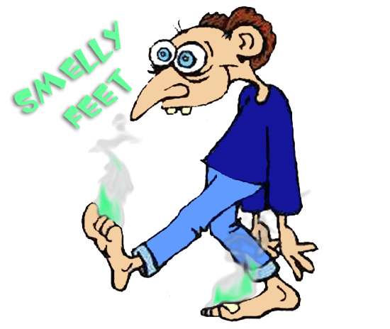
mustiness
Noun
The odor or flavor of mold; stale moldy smell or taste
When we opened the door to the basement we were overcome with a foul mustiness.
Notes:
Input:
Have students to identify the part of speech, read the definition and the sentence.
Clarify/restate any information that is unclear or inaccurate.
Point out the suffix on the word
CFU:
Ask a student to give a paraphrase of the definition
Ask a different student to provide an example or another sentence using the word

Slide 7
preparedness
Noun
The state of being prepared or ready, especially for war
The country’s preparedness for war was not satisfactory, so it did not aggravate its enemies.

Slide 8
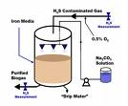
purification
Noun
The act of removing pollution, impruities, contamination or guilt
In processing food, purification is one of the most important steps.
Notes:
Input:
Have students to identify the part of speech, read the definition and the sentence.
Clarify/restate any information that is unclear or inaccurate.
Point out the suffix on the word
CFU:
Ask a student to give a paraphrase of the definition
Ask a different student to provide an example or another sentence using the word

Slide 9
resentment
Noun
Strong feelings of anger because of insult or wrong; bitterness
Her feelings of resentment toward her sister prevented a close relationship.
Notes:
Input:
Have students to identify the part of speech, read the definition and the sentence.
Clarify/restate any information that is unclear or inaccurate.
Point out the suffix on the word
CFU:
Ask a student to give a paraphrase of the definition
Ask a different student to provide an example or another sentence using the word

Slide 10
seemliness
Noun
The state of being fit or appropriate
The seemliness of the committee’s actions were questioned by the citizens.
Notes:
Input:
Have students to identify the part of speech, read the definition and the sentence.
Clarify/restate any information that is unclear or inaccurate.
Point out the suffix on the word
CFU:
Ask a student to give a paraphrase of the definition
Ask a different student to provide an example or another sentence using the word

Slide 11
suspension
Noun
The state of hanging; state of discontinuing something
The class’s bad behavior resulted in the suspension of its gym privileges.
Notes:
Input:
Have students to identify the part of speech, read the definition and the sentence.
Clarify/restate any information that is unclear or inaccurate.
Point out the suffix on the word
CFU:
Ask a student to give a paraphrase of the definition
Ask a different student to provide an example or another sentence using the word

Slide 12
verification
Noun
The act of checking the truth or correctness of something
Before signing a document, get verification that all the facts are correct.
Notes:
Input:
Have students to identify the part of speech, read the definition and the sentence.
Clarify/restate any information that is unclear or inaccurate.
Point out the suffix on the word
CFU:
Ask a student to give a paraphrase of the definition
Ask a different student to provide an example or another sentence using the word

Slide 13
Practice Using the New Words!
Notes:
The independent practice that goes with this lesson will be introduced with this slide. As it is modified, I will not present it on the PPT or SB as that may cause confusion for the students who have the unmodified version. However, the following is how I will review the worksheet with the whole class:
Input:
Read the directions for the first section.
CFU: Ask if there are any questions
Guided Practice/Modeling:
Read the two words listed for the first question.Ask if the two words have the same meaning or different meanings. Model looking up the meaning for construe – note that assume the meaning is part of the definition. Have a student say that the words have the same meaning. Have the students circle same. Tell them they will do the same for 2-8.
CFU: ask if there are questions
Input: read the directions for the second section
Guided Practice: read the word for #9. Explain that they are to determine the meaning of port and then add the meaning of er. Give the example of teach + er…someone who teaches. Say to do the same thing for port, but that someone who ports doesn’t make sense, so they will need to look at the MEANING for port…to carry from one palace to another. A porter is someone who carries things from one place to another. Have students write in answer. Tell them to do the remaining two questions the same way.
CFU ask for questions.
Input: read the directions for the third question.
G.P. Do the first one together. Have three different students name one thing that is portable. Have students write in the answers.
CFU ask for questions
IP: have students complete the worksheet independently. CFU: circulate. Monitor for correct answers. If time allows when students are finished, go over the answers as class.
Closure: Remind students to review the words during the week. Remind them that if they learn the root words they will add more than just those ten words to their vocabulary. Have students turn in worksheets to appropriate areas.

