Slide 1
Vocabulary
Red Hot Root Words

Slide 2
Suffixes
Suffixes Meaning Words You Already Know
acy condition democracy
tude condition attitude
ure condition capture
Notes:
Input:
Present the root words” Explain their meanings.
CFU:
Ask students to tell you another word with fore
Repeat with other root words.

Slide 3
accuracy
Noun
State of being exactly truthful and free of errors; precision
Being an accountant requires accuracy.
Notes:
Input:
Present the word
State the part of speech
Read the definition and sentence
Point out the suffix on the word
Tell students to make sure they are familiar with how the word is used in the sentence
CFU:
Ask a student to give a paraphrase, example, or another sentence
Ask a different student to provide an example or another sentence using the word
Model:
If students are not able to do the CFU, provide a paraphrase and an example
Do this for any word that the students cannot paraphrase or give an example for.

Slide 4
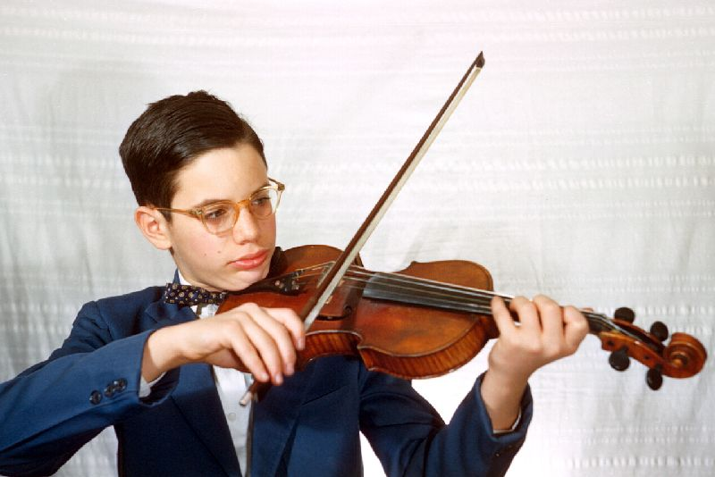
aptitude
Noun
A capacity or ability for anything; ability, readiness to learn
He showed an aptitude for playing the violin at a young age.
Notes:
Input:
For each of the following slides (with vocabulary words) have each student in turn:
Present the word
State the part of speech
Read the definition and sentence
Point out the suffix on the word
CFU:
Ask one of the other students to give a paraphrase of the definition, and another to provide an example or another sentence using the word.
Provide positive verbal feedback for each.
Restate the example or paraphrase if unclear how it relates (informal error correction)

Slide 5
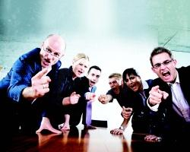
censure
Noun
Strong expression of disapproval; criticism
The punishment was meant to censure the peasants’ actions.
Notes:
Input:
Have students to identify the part of speech, read the definition and the sentence.
Clarify/restate any information that is unclear or inaccurate.
Point out the suffix on the word
CFU:
Ask a student to give a paraphrase of the definition
Ask a different student to provide an example or another sentence using the word

Slide 6
forfeiture
Noun
The state of losing some right, property, honor, or privilege as a penalty
His poor management of the business caused the forfeiture of the building and all the merchandise to his creditors.
Notes:
Input:
Have students to identify the part of speech, read the definition and the sentence.
Clarify/restate any information that is unclear or inaccurate.
Point out the suffix on the word
CFU:
Ask a student to give a paraphrase of the definition
Ask a different student to provide an example or another sentence using the word

Slide 7
immature
Adjective
Not mature; unripe or underdeveloped
Throwing a temper tantrum is immature behavior. You should be able to express your feelings without acting like a child.

Slide 8
lassitude
Noun
Lack of energy; exhaustion; weariness
Hot summer days bring on feelings of lassitude, and all I want to do is lay around and do nothing.
Notes:
Input:
Have students to identify the part of speech, read the definition and the sentence.
Clarify/restate any information that is unclear or inaccurate.
Point out the suffix on the word
CFU:
Ask a student to give a paraphrase of the definition
Ask a different student to provide an example or another sentence using the word

Slide 9
literacy
Noun
The ability to read and write
Literacy is essential if you are going to get a good, well-paying job.
Notes:
Input:
Have students to identify the part of speech, read the definition and the sentence.
Clarify/restate any information that is unclear or inaccurate.
Point out the suffix on the word
CFU:
Ask a student to give a paraphrase of the definition
Ask a different student to provide an example or another sentence using the word

Slide 10
lunacy
Noun
Insanity, craziness; frenzy; mental unsoundness
My brother’s decision to quit his job is pure lunacy.
Notes:
Input:
Have students to identify the part of speech, read the definition and the sentence.
Clarify/restate any information that is unclear or inaccurate.
Point out the suffix on the word
CFU:
Ask a student to give a paraphrase of the definition
Ask a different student to provide an example or another sentence using the word

Slide 11
rapture
Noun
State of being carried away with extreme joy; ecstasy; bliss
When I fell in love I was in a state of complete, unrestrained rapture.
Notes:
Input:
Have students to identify the part of speech, read the definition and the sentence.
Clarify/restate any information that is unclear or inaccurate.
Point out the suffix on the word
CFU:
Ask a student to give a paraphrase of the definition
Ask a different student to provide an example or another sentence using the word

Slide 12
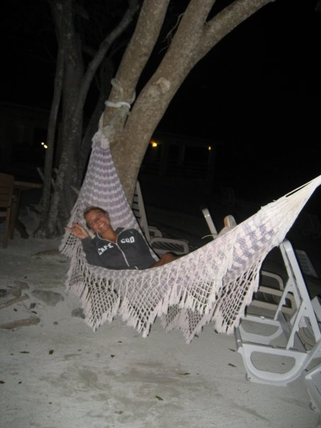
solitude
Noun
State of being alone’ seclusion
Sometimes when I am really tired, I like to have complete solitude so I can rest and relax.
Notes:
Input:
Have students to identify the part of speech, read the definition and the sentence.
Clarify/restate any information that is unclear or inaccurate.
Point out the suffix on the word
CFU:
Ask a student to give a paraphrase of the definition
Ask a different student to provide an example or another sentence using the word

Slide 13
Practice Using the New Words!
Notes:
The independent practice that goes with this lesson will be introduced with this slide. As it is modified, I will not present it on the PPT or SB as that may cause confusion for the students who have the unmodified version. However, the following is how I will review the worksheet with the whole class:
Input:
Read the directions for the first section.
CFU: Ask if there are any questions
Guided Practice/Modeling:
Read the two words listed for the first question.Ask if the two words have the same meaning or different meanings. Model looking up the meaning for construe – note that assume the meaning is part of the definition. Have a student say that the words have the same meaning. Have the students circle same. Tell them they will do the same for 2-8.
CFU: ask if there are questions
Input: read the directions for the second section
Guided Practice: read the word for #9. Explain that they are to determine the meaning of port and then add the meaning of er. Give the example of teach + er…someone who teaches. Say to do the same thing for port, but that someone who ports doesn’t make sense, so they will need to look at the MEANING for port…to carry from one palace to another. A porter is someone who carries things from one place to another. Have students write in answer. Tell them to do the remaining two questions the same way.
CFU ask for questions.
Input: read the directions for the third question.
G.P. Do the first one together. Have three different students name one thing that is portable. Have students write in the answers.
CFU ask for questions
IP: have students complete the worksheet independently. CFU: circulate. Monitor for correct answers. If time allows when students are finished, go over the answers as class.
Closure: Remind students to review the words during the week. Remind them that if they learn the root words they will add more than just those ten words to their vocabulary. Have students turn in worksheets to appropriate areas.

