Slide 1
Vocabulary
Red Hot Root Words

Slide 2
Suffixes
Suffixes Meaning Words You Already Know
ish resembling, like childish
ly resembling, like manly
oid resembling, like spheroid
some resembling, like handsome
Notes:
Input:
Present the root words” Explain their meanings.
CFU:
Ask students to tell you another word with fore
Repeat with other root words.

Slide 3
amateurish
Adjective
Like an amateur, crude; lacking professional finish
The amateurish video was amusing even if it was imperfect.
Notes:
Input:
Present the word
State the part of speech
Read the definition and sentence
Point out the suffix on the word
Tell students to make sure they are familiar with how the word is used in the sentence
CFU:
Ask a student to give a paraphrase, example, or another sentence
Ask a different student to provide an example or another sentence using the word
Model:
If students are not able to do the CFU, provide a paraphrase and an example
Do this for any word that the students cannot paraphrase or give an example for.

Slide 4
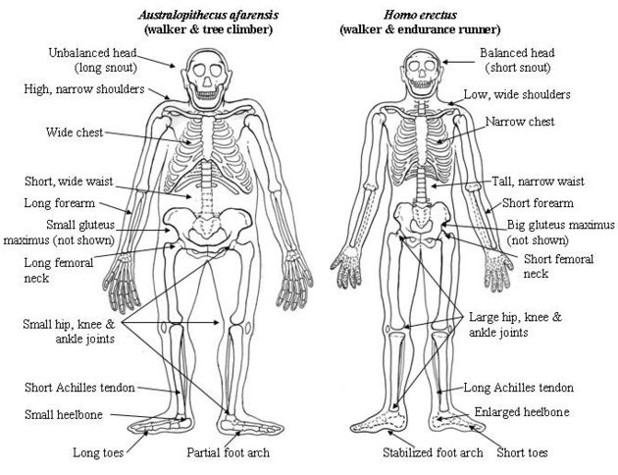
anthropoid
Adjective
Resembling a human being, especially when referring to the most highly developed apes
Gorillas, orangutans and chimpanzees have some anthropoid features.
Notes:
Input:
For each of the following slides (with vocabulary words) have each student in turn:
Present the word
State the part of speech
Read the definition and sentence
Point out the suffix on the word
CFU:
Ask one of the other students to give a paraphrase of the definition, and another to provide an example or another sentence using the word.
Provide positive verbal feedback for each.
Restate the example or paraphrase if unclear how it relates (informal error correction)

Slide 5
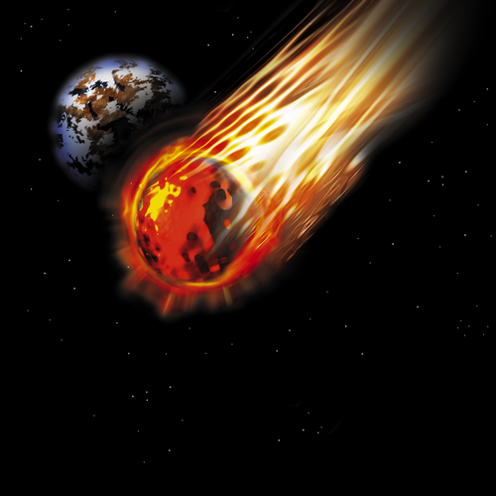
asteroid
Noun
Small celestial bodies that revolve around the sun
We were able to see the asteroid shower without using a telescope.
Notes:
Input:
Have students to identify the part of speech, read the definition and the sentence.
Clarify/restate any information that is unclear or inaccurate.
Point out the suffix on the word
CFU:
Ask a student to give a paraphrase of the definition
Ask a different student to provide an example or another sentence using the word

Slide 6
Brutish
Adjective
Savage and stupid; like a cruel, insensitive person
Her brutish behavior made everyone fear her; but no one respected her
Notes:
Input:
Have students to identify the part of speech, read the definition and the sentence.
Clarify/restate any information that is unclear or inaccurate.
Point out the suffix on the word
CFU:
Ask a student to give a paraphrase of the definition
Ask a different student to provide an example or another sentence using the word

Slide 7
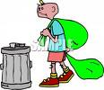
loathsome
Adjective
Disgusting, revolting; causing great dislike
I think taking out the garbage is a loathsome task.

Slide 8
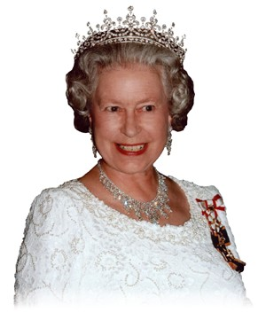
prudish
Adjective
Excessively proper or modest
My grandmother was a prudish woman, always concerned about what was proper.
Notes:
Input:
Have students to identify the part of speech, read the definition and the sentence.
Clarify/restate any information that is unclear or inaccurate.
Point out the suffix on the word
CFU:
Ask a student to give a paraphrase of the definition
Ask a different student to provide an example or another sentence using the word

Slide 9
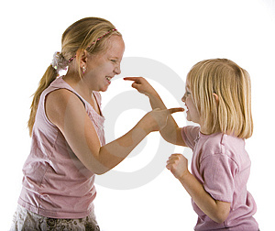
quarrelsome
Adjective
Inclined to argue or disagree
My sister has a very quarrelsome nature, so it’s hard to carry on a civil conversation with her.
Notes:
Input:
Have students to identify the part of speech, read the definition and the sentence.
Clarify/restate any information that is unclear or inaccurate.
Point out the suffix on the word
CFU:
Ask a student to give a paraphrase of the definition
Ask a different student to provide an example or another sentence using the word

Slide 10
saintly
Adjective
Like a saint; patient and caring
My second grade teacher was saintly. She was always so kind and caring.
Notes:
Input:
Have students to identify the part of speech, read the definition and the sentence.
Clarify/restate any information that is unclear or inaccurate.
Point out the suffix on the word
CFU:
Ask a student to give a paraphrase of the definition
Ask a different student to provide an example or another sentence using the word

Slide 11
tabloid
Noun
A smaller version of a newspaper, often with more sensational news.
You will find the tabloids sold next to the check out stand of the market.
Notes:
Input:
Have students to identify the part of speech, read the definition and the sentence.
Clarify/restate any information that is unclear or inaccurate.
Point out the suffix on the word
CFU:
Ask a student to give a paraphrase of the definition
Ask a different student to provide an example or another sentence using the word

Slide 12
winsome
Adjective
Charming, engaging
Her winsome ways won the hearts of everyone she met.
Notes:
Input:
Have students to identify the part of speech, read the definition and the sentence.
Clarify/restate any information that is unclear or inaccurate.
Point out the suffix on the word
CFU:
Ask a student to give a paraphrase of the definition
Ask a different student to provide an example or another sentence using the word

Slide 13
Practice Using the New Words!
Notes:
The independent practice that goes with this lesson will be introduced with this slide. As it is modified, I will not present it on the PPT or SB as that may cause confusion for the students who have the unmodified version. However, the following is how I will review the worksheet with the whole class:
Input:
Read the directions for the first section.
CFU: Ask if there are any questions
Guided Practice/Modeling:
Read the two words listed for the first question.Ask if the two words have the same meaning or different meanings. Model looking up the meaning for construe – note that assume the meaning is part of the definition. Have a student say that the words have the same meaning. Have the students circle same. Tell them they will do the same for 2-8.
CFU: ask if there are questions
Input: read the directions for the second section
Guided Practice: read the word for #9. Explain that they are to determine the meaning of port and then add the meaning of er. Give the example of teach + er…someone who teaches. Say to do the same thing for port, but that someone who ports doesn’t make sense, so they will need to look at the MEANING for port…to carry from one palace to another. A porter is someone who carries things from one place to another. Have students write in answer. Tell them to do the remaining two questions the same way.
CFU ask for questions.
Input: read the directions for the third question.
G.P. Do the first one together. Have three different students name one thing that is portable. Have students write in the answers.
CFU ask for questions
IP: have students complete the worksheet independently. CFU: circulate. Monitor for correct answers. If time allows when students are finished, go over the answers as class.
Closure: Remind students to review the words during the week. Remind them that if they learn the root words they will add more than just those ten words to their vocabulary. Have students turn in worksheets to appropriate areas.

