Slide 1
Red Hot Word Parts
Lesson 45
Suffixes
al
ine
ous

Slide 2
What do you notice?
Usual
Natural
Masculine
Genuine
Mysterious
Delicious

Slide 3
al like, pertaining to usual, natural ine like, pertaining to masculine,genuine ous like, pertaining to mysterious, delicious
Suffixes and Meanings

Slide 4
autumnal
(adj)-characteristic of autumn/blooming in autumn
While it was only August, the weather was very autumnal: crisp, damp, and cold.

Slide 5
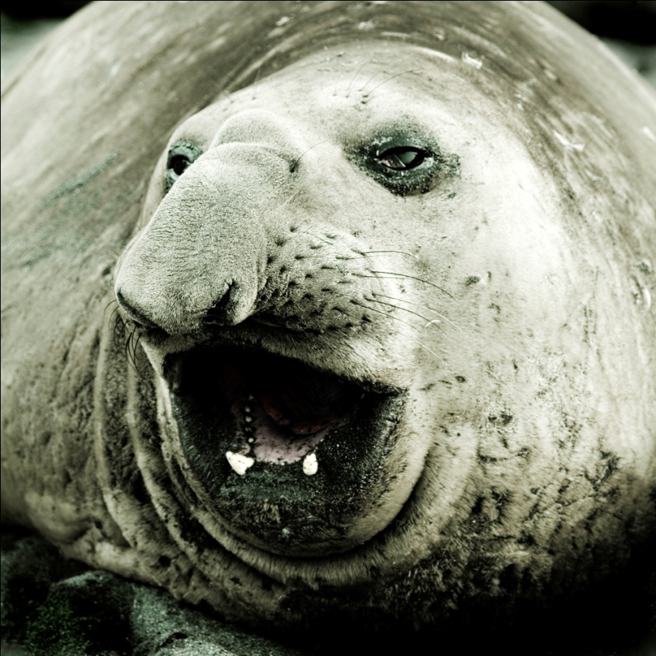
elephantine
(adj)-large and clumsy; resembling an elephant
The elephantine sea lion was graceful in the water but clumsy on land.

Slide 6
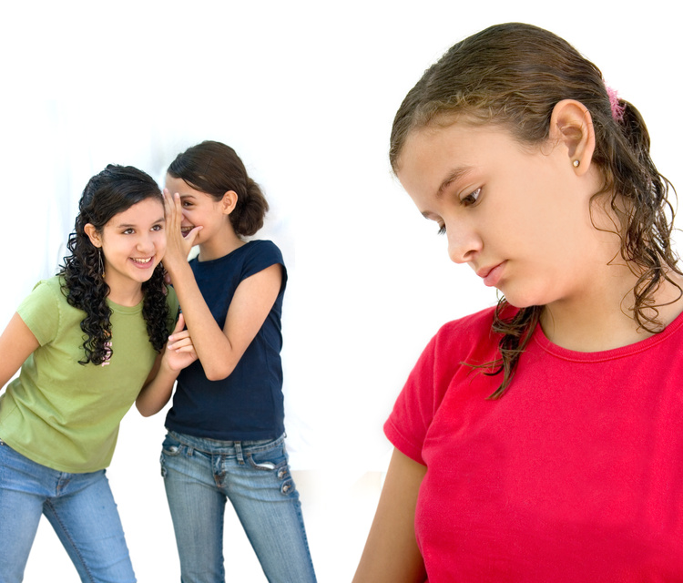
malicious
(adj)-characterized by ill will with the desire to cause harm; spitefull
Malicious gossip hurts the person who spreads it as well as the person it is about.

Slide 7
phenomenal
(adj)-extraordinary; pertaining to strange, uncommon or remarkable things
The store had phenomenal business the first day it opened.

Slide 8

political
(adj)-concerning politics and government
His political career included being a governor and a senator.

Slide 9
pristine
(adj)-pertaining to an earlier state or condition; original
When she opened the antique trunk, she found many old clothes in pristine condition.

Slide 10
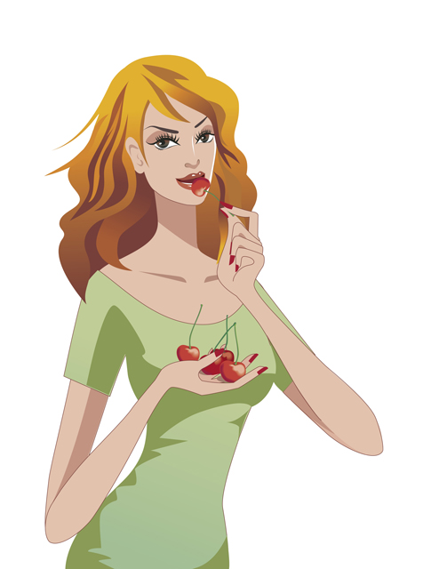
saccharine
(adj)-sweet; sugary
Her saccharine personality made people feel that she was not genuine.

Slide 11
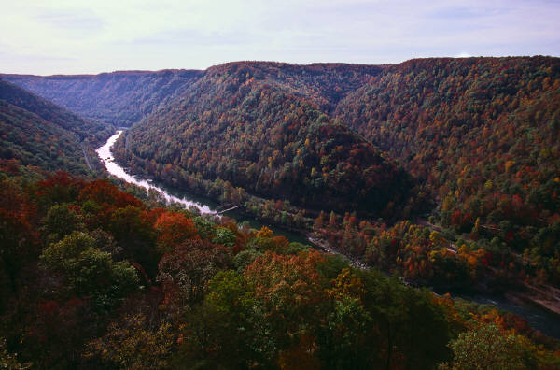
serpentine
(adj)-like a snake; winding; crafty
The serpentine river wound its way through the hilly countryside.

Slide 12
slanderous
(adj)-related to false statements made about someone
The mayor was angry that someone in town was making statements about him that he considered slanderous.

Slide 13
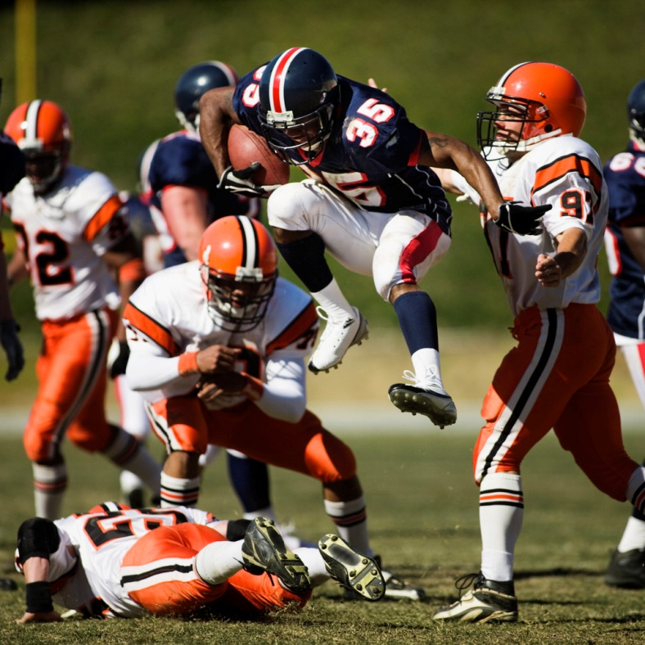
voracious
(adj)-greedy; unable to be satisfied; eager to eat a lot of food
The football players had voracious appetites after each practice.

Slide 14
Now Practice using the words!
Good luck!

