Slide 1
Red hot root words –
Lesson 2
Notes:
MONDAY (8/31): DETAILED INTRODUCTION
(Because time is short and I have learned that these students need to have new words introduced clearly and slowly, only the first four words will be introduced and reviewed today. These are the words with the “hyper” prefix. Both these words and the remaining six words with the “super” prefix will be briefly introduced in general education reading today. Tomorrow, the ‘hyper’ words will be briefly reviewed and the ‘super’ words reviewed in depth in this class tomorrow.)
Input: Review the words with the students. Speak slowly and clearly. First remind students that all of these prefixes mean above, over, and more, so they will need to be careful to use the correct prefix when working with these words. Next, introduce each word one at a time (will come in one at a time on the slide when it is clicked). Say the word, its part of speech, and its definition. Read the sentence, stressing the vocabulary word.
Model:(in advance for activity on next slide) Provide an example, a different sentence, or a clearer explanation for each word. (For example, discuss how I catch a tiny fish as big as my hand, but when I tell people about it I say it was huge; at least as big as my entire leg.) Try to relate them to the students life, interests, or prior knowledge. Tell the students that they will be asked to do this themselves with the next slide.
Check for understanding: After each word is introduced as noted above, ask students if they understand or have any questions. Monitor facial expressions for confusion. Encourage students to ask questions or give examples.
Input: After all of the words have been introduced slowly, one at a time, go back over the list quickly and paraphrase each of the definitions. Be dramatic if possible to show the students how “hyper” is “above, over, more.” Make sure there are no questions before going to slide 3.
TUESDAY 9/1
Input: Briefly review the words on this slide. Read the words and definitions to the students.
Check for Understanding: Ask a student to give an example of hyperbole and another to give a paraphrase of hyperthermia. Ask if there are any questions on these words before you move on to the “super” words. Monitor facial expressions for confusion.

Slide 2
Don’t Forget…
PREFIXES -MEANING
-sub -below, under
-trans -across, over

Slide 3
What Do You Notice?
Hypercritical
Hypertension
Hyperbole
Surplus
Surcharge
Supernatural

Slide 4
PREFIXES MEANING
HYPER ABOVE, OVER, MORE SUPER, SUPR, SUR ABOVE, OVER, MORE

Slide 5
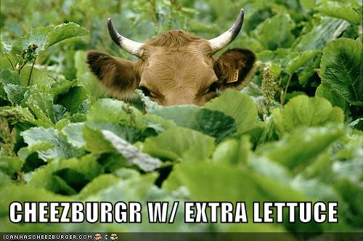
HYPERBOLE
Noun
AN INTENTIONAL STATEMENT OF EXAGGERATION
Her statement that she was so hungry she could eat a cow was hyperbole.

Slide 6

HYPERCRITICAL
Adjective
EXCESSIVELY CRITICAL
His mother was hypercritical, always finding fault with his behavior.

Slide 7
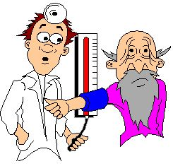
HYPERTENSION
Noun
EXTREME TENSION; HIGH BLOOD PRESSURE
Speaking before an audience gives me hypertension.

Slide 8
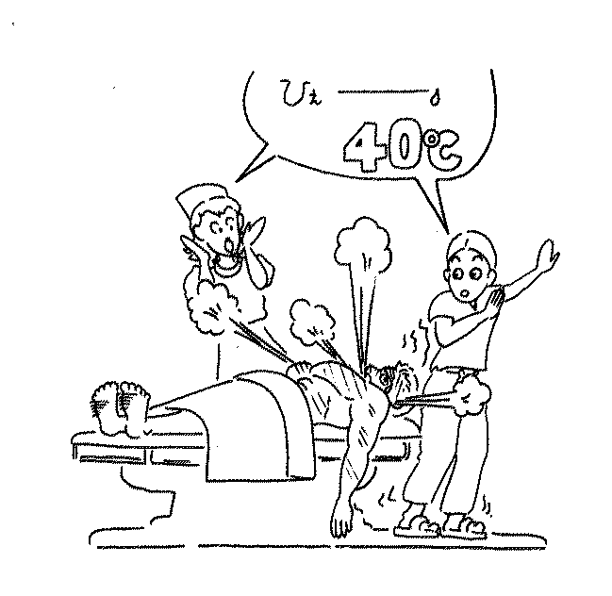
HYPERTHERMIA
Noun
HIGH TEMPERATURE
After two days of hyperthermia, he decided to see a doctor

Slide 9
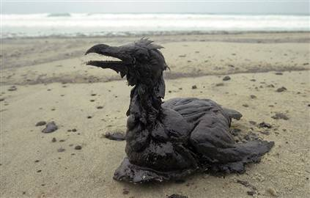
SUPERIMPOSE
(V)
TO LAY ONE ITEM ON TOP OF ANOTHER
The magazine cover featured the picture of a bird superimposed over the image of an oil spill.

Slide 10
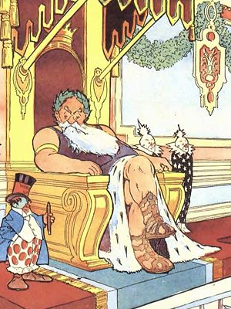
SUPERLATIVE
(ADJ)
OF THE HIGHEST ORDER; BEST; GREATEST
The king was the superlative ruler, more powerful than princes, dukes, or lords

Slide 11

SUPERNATURAL
(ADJ)
BEYOND THE LAWS OF NATURE
The movie featured many supernatural encounters that were scary.

Slide 12
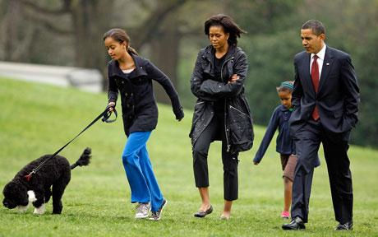
SUPERVISE
(V)
TO OVERSEE
If you don’t constantly supervise this dog, he will chew up everything in this room.

Slide 13
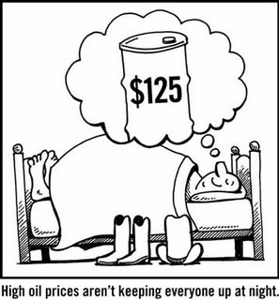
SURCHARGE
(N)
ADDITIONAL CHARGE OR TAX
The city’s surcharge on all hotel bills is called a bed tax.

Slide 14
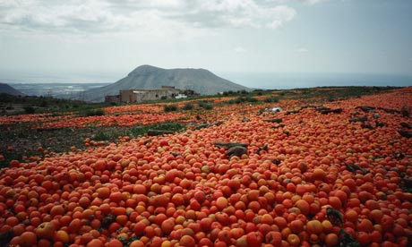
SURPLUS
(N)
MORE THAN WHAT IS NEEDED
Every year, my dad has a surplus of zucchini and has to give it away to the neighbors.

Slide 15
In My Own Words…
Use SUPERIMPOSE in a sentence of your own…
Explain SUPERLATIVE as if you were teaching a friend what it means…
Give an example of the SUPERNATURAL…
Provide an antonym and a synonym for SUPERVISE…
Have you ever been given a SURCHARGE? Tell us about it…
Give an example of a SURPLUS…
Notes:
Tuesday 9/1 after detailed review of “super” words:
Input: Tell the students that the best way to make new words familiar is to think about them and use them. Tell them that you are going to help them do that by asking them to give answers to the questions on the slide. Remind students that you would like them to raise their hands and volunteer to answer, but that you will call on them to answer if they do not do it on their own. (Do NOT allow D, S, or J to answer more than one question.)
Check for Understanding/Guided Practice: Call on students to answer the questions on the slide. Provide prompting as necessary. If students are slow to start in responding to questions.
Independent Practice: There is no independent practice for this lesson. However, data will be collected regarding behavior and also if students are able to give correct answers to the guided practice questions.
Closure: Tell the students that tomorrow we will review all of the words together very quickly, and then we will be doing a quick matching activity. Tell them that there is no homework, but it would be helpful to them to review their words before tomorrow. (Tuesday’s lesson includes slides 1, 2, 3, 5, and 10)

Slide 16
In My Own Words…
Provide an example of a time when you have used HYPERBOLE…
Name someone who is HYPERCRITICAL and tell why you think this…
What gives you HYPERTENSION?
What is an antonym for HYPERTHERMIA? Name a synonym as well…
Notes:
Monday 8/31: After reviewing “hyper” words:
Input: Tell the students that the best way to make new words familiar is to think about them and use them. Tell them that you are going to help them do that by asking them to give answers to the questions on the slide. Remind students that you would like them to raise their hands and volunteer to answer, but that you will call on them to answer if they do not do it on their own. (Do NOT allow D, S, or J to answer more than one question.)
Check for Understanding/Guided Practice: Call on students to answer the questions on the slide. Provide prompting as necessary. If students are slow to start in responding to questions.
Independent Practice: There is no independent practice for this lesson. However, data will be collected regarding behavior and also if students are able to give correct answers to the guided practice questions.
Closure: Tell the students that they will be seeing these same words again in Reading today along with six other words that we will go over more tomorrow. Thank them for working hard and tell them that their hard work will make Reading class a “piece of cake” today.
Slides 1-3 and 10 are Monday’s lesson.

Slide 17
MATCHING…
Fill the blank with the letter of the definition that matches the vocabulary word.
1. HYPERBOLE _______ A. BEYOND THE LAWS OF NATURE
2. HYPERCRITICAL ______ B. TO LAY ONE ITEM ON TOP OF ANOTHER
3. HYPERTENSION _______ C. OF THE HIGHEST ORDER; BEST; GREATEST
4. HYPERTHERMIA_______ D. HIGH TEMPERATURE
5. SUPERIMPOSE _______ E. MORE THAN WHAT IS NEEDED
6. SUPERLATIVE _______ F. AN INTENTIONAL STATEMENT OF
EXAGGERATION
7. SUPERNATURAL (ADJ) _______ G. TO OVERSEE
8. SUPERVISE (V) _______ H. EXTREME TENSION; HIGH BLOOD PRESSURE
9. SURCHARGE (N) _______ I. ADDITIONAL CHARGE OR TAX
10. SURPLUS (N) _______ J. EXCESSIVELY CRITICAL
Notes:
Wednesday 9/2 after brief review of all ten vocabulary words on slide 6:
Give each student a copy of the worksheet that matches this slide. Make sure they have a pen/pencil out.
Input: Tell the students that they are going to be completing this worksheet in class today and that as soon as they are done with it they can use the remaining time to work on other homework or read. Read the directions aloud.
Modeling: Have one of the (tall) students come to the SmartBoard. Have him/her read number 1. Demonstrate reading through the definitions until you see the one that matches hyperbole (F). Have the student write the F in the blank next to number 1 and cross off that definition.
Guided Practice: Read #2 aloud. Tell the students to find the definition that matches and write the letter in the blank using their worksheets. After waiting about one minute, have someone provide the answer. Praise, fill in the answer on the SmartBoard and cross definition J off of the list .
Independent practice: Have the students complete the worksheet on their own. Collect worksheets when completed for data.
Check for Understanding: While students are working, circulate among their desks and look for correct answers, participation or non-compliance, and facial expressions indicating understanding.
Closure: Remind the students that they will be having a quiz on Friday on these words and the words from last week, and that working on the words in this class will help them to do well. Tell the students that as soon as they are finished with their worksheets to put them on my desk and then continue working on any other work they might have.
Wednesday’s lesson includes slides 1, 6, 7, and 10.

Slide 18
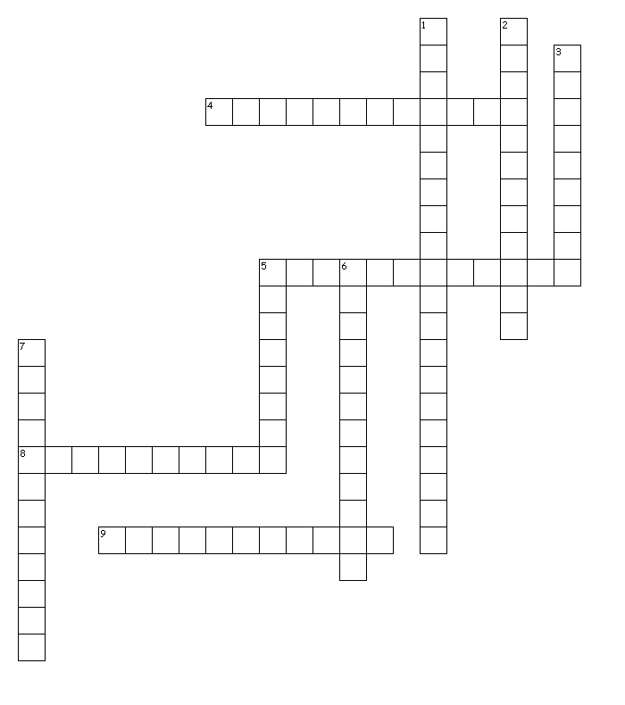
Red Hot Root Words Crosswords
Across
4. INTENTIONAL STATEMENT OF EXAGGERATION
5. FURNISH MONEY OR ASSIST WITH THE PAYMENT OF MONEY
8. ADDITIONAL CHARGE OR TAX
9. TO MAKE A WRITTEN COPY
Down
1. TENSION; HIGH BLOOD PRESSURE
2. CHANGE IN FORM OR APPEARANCE
3. CONQUER OR BRING UNDER CONTROL
5. MORE THAN WHAT IS NEEDED
6. OF THE HIGHEST ORDER; BEST; GREATEST
7. PERMITTING SOME LIGHT TO PASS
THROUGH BUT GIVING AN UNCLEAR IMAGE
Word Bank
transcribe subdue
hypertension translucent
subsidize hyperbole
transform surplus
surcharge superlative
Notes:
Thursday 9/4 after brief review of slide 6:
Give each student a copy of the worksheet that matches this slide. Make sure they have a pen/pencil out.
Input: Tell the students that they are going to be completing this crossword puzzle in class today and that as soon as they are done with it they can use the remaining time to work on other homework or read. Read the directions aloud.
Guided Practice/Modeling: Have one of the students come to the SmartBoard and read 4 across. Model using the word bank to find the correct answer (surplus). Have the student write the answer into the puzzle. Cross the words out when they are used. Read 4 down aloud. Tell the students to find the word in the word bank that matches it and write the answer in the blanks for 1 down. After waiting about one minute, have someone provide the answer. Praise, fill in the answer on the SmartBoard and cross supervise off of the list .
Independent practice: Have the students complete the crossword on their own. Collect worksheets when completed for data.
Check for Understanding: While students are working, circulate among their desks and look for correct answers, participation or non-compliance, and facial expressions indicating understanding. Provide prompting as necessary.
Closure: Remind the students that they will be having a quiz on Friday on these words and the words from last week, and that working on the words in this class will help them to do well. Tell the students that as soon as they are finished with their crossword puzzles to put them on my desk and then continue working on any other work they might have.
Thursday’s lesson includes slides 1, 6, 8, and 10.

Slide 19
RED HOT ROOT WORDS: IN YOUR OWN WAY
Select a vocabulary word and its definition.
Take a piece of paper and write the word and its definition on the top. (Write small!)
On the bottom of the paper, in your own way, show the meaning of the word. You can:
  Draw a picture showing what the vocabulary word means
  Write a sentence using the vocabulary word
  Write the definition the way you explain it to a friend
  Write 2 synonyms and 2 antonyms for the vocabulary word
Select another vocabulary word and definition and do it again with the new word.
When you have done two vocabulary words, glue your work to the poster
Notes:
Friday 9/4: after a quick review of word list on slide 6
Input: Review the steps on the slide. Remind students that this activity is the same one that they did last Friday, but they will be using this week’s words instead.
Modeling: Show a picture (drawn in advance) of an overflowing garbage can. Include a sentence using the word and a paraphrase of the definition. Leave it for the students to use as they draw their own.
Check for Understanding: Ask if anyone has questions. Monitor facial expressions for confusion.
Input: Have the students to come up one at a time to get a card and definition. Give them a choice of working at the group tables with a word and definition list or at their desks using the SmartBoard and the word list from slide 6. Collect the cards as soon as the students have the word and definition written so that they are available to use for the second word.
GP/IP: Ask CT and PA to assist as students complete first response but not to assist with the second response. Record accuracy of student responses and appropriate behavior on data sheet. Monitor students as they work and provide prompting as necessary.
Closure: As students complete activity, remind them to study their vocabulary words. Remind them of the upcoming quiz in the next class. Tell them that they will be getting a new list of words on Monday and that we will be using some of the strategies we used this week with the new words. (Leave the poster up on the wall for display.)
Friday’s lesson includes slides 1, 6, 9, and 10

