Slide 1
Vocabulary
Red Hot Root Words

Slide 2
ROOTS
Root Words Meaning Words You Already Know
mori, mort death mortal
nat birth nation
vit, viv life survive
Notes:
Input:
Present the root words” Explain their meanings.
CFU:
Ask students to tell you another word with fore
Repeat with other root words.

Slide 3
innate
Adjective
Natural; inborn; not acquired
Her ability to sing was innate, and she needed no training
Notes:
Input:
Present the word
State the part of speech
Read the definition and sentence
Point out the suffix on the word
Tell students to make sure they are familiar with how the word is used in the sentence
CFU:
Ask a student to give a paraphrase, example, or another sentence
Ask a different student to provide an example or another sentence using the word
Model:
If students are not able to do the CFU, provide a paraphrase and an example
Do this for any word that the students cannot paraphrase or give an example for.

Slide 4
international
Adjective
Between two or more nations
His international travels took him to several countries in Europe and Africa.
Notes:
Input:
For each of the following slides (with vocabulary words) have each student in turn:
Present the word
State the part of speech
Read the definition and sentence
Point out the suffix on the word
CFU:
Ask one of the other students to give a paraphrase of the definition, and another to provide an example or another sentence using the word.
Provide positive verbal feedback for each.
Restate the example or paraphrase if unclear how it relates (informal error correction)

Slide 5
morbid
Adjective
Unhealthy; diseased; showing an unhealthy tendency to think about gruesome or gloomy things
He had a morbid fascination with movies dealing with violence and death.
Notes:
Input:
Have students to identify the part of speech, read the definition and the sentence.
Clarify/restate any information that is unclear or inaccurate.
Point out the suffix on the word
CFU:
Ask a student to give a paraphrase of the definition
Ask a different student to provide an example or another sentence using the word

Slide 6
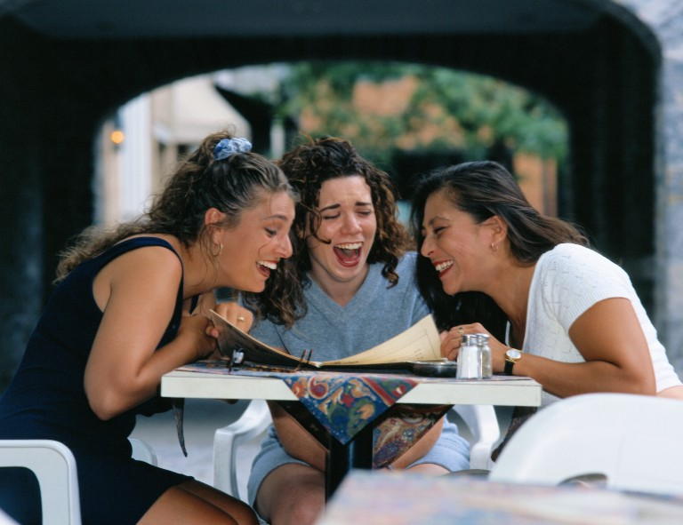
mortify
Verb
To humiliate or shame
She was mortified when her mother showed her friends her baby pictures.
Notes:
Input:
Have students to identify the part of speech, read the definition and the sentence.
Clarify/restate any information that is unclear or inaccurate.
Point out the suffix on the word
CFU:
Ask a student to give a paraphrase of the definition
Ask a different student to provide an example or another sentence using the word

Slide 7
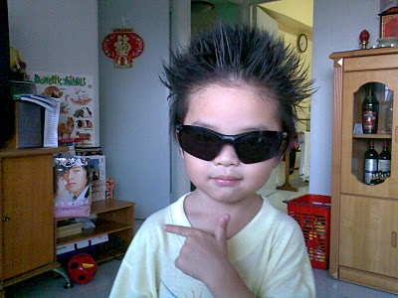
naive
adjective
Simple; unaffected; unsophisticated
James was so naïve that he believed anything his older brother told him.

Slide 8
nationality
Noun
Membership of a particular nation either by birth or naturalization
The traveler’s nationality was French, but he had been living in Germany for five years.
Notes:
Input:
Have students to identify the part of speech, read the definition and the sentence.
Clarify/restate any information that is unclear or inaccurate.
Point out the suffix on the word
CFU:
Ask a student to give a paraphrase of the definition
Ask a different student to provide an example or another sentence using the word

Slide 9
remorse
Noun
Extreme guilt for one’s actions
I feel remorse for saying things that hurt her feelings.
Notes:
Input:
Have students to identify the part of speech, read the definition and the sentence.
Clarify/restate any information that is unclear or inaccurate.
Point out the suffix on the word
CFU:
Ask a student to give a paraphrase of the definition
Ask a different student to provide an example or another sentence using the word

Slide 10
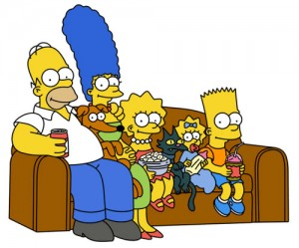
vitalize
Verb
To give life and energy to
Her guest appearance vitalized the otherwise boring sitcom.
Notes:
Input:
Have students to identify the part of speech, read the definition and the sentence.
Clarify/restate any information that is unclear or inaccurate.
Point out the suffix on the word
CFU:
Ask a student to give a paraphrase of the definition
Ask a different student to provide an example or another sentence using the word

Slide 11
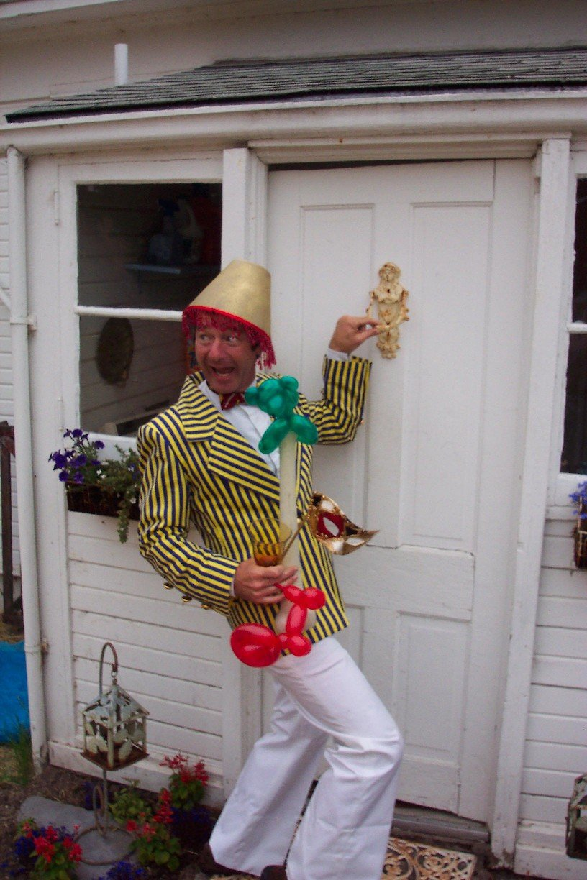
vivacious
Adjective
Lively; active; spirited
The vivacious youngster was the life of the party.
Notes:
Input:
Have students to identify the part of speech, read the definition and the sentence.
Clarify/restate any information that is unclear or inaccurate.
Point out the suffix on the word
CFU:
Ask a student to give a paraphrase of the definition
Ask a different student to provide an example or another sentence using the word

Slide 12
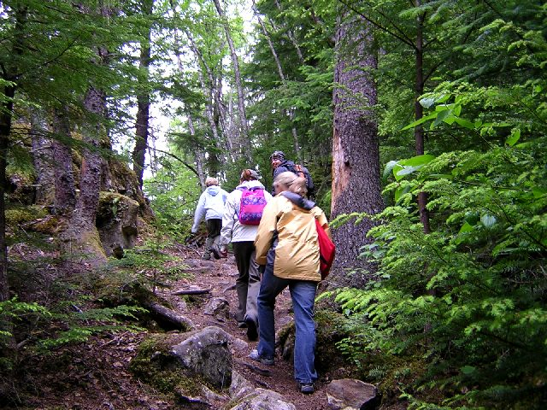
vivid
Adjective
Bright, intense, (usually color or light); full of life
I have vivid memories of all the wonderful things we saw on the hike.
Notes:
Input:
Have students to identify the part of speech, read the definition and the sentence.
Clarify/restate any information that is unclear or inaccurate.
Point out the suffix on the word
CFU:
Ask a student to give a paraphrase of the definition
Ask a different student to provide an example or another sentence using the word

Slide 13
Practice Using the New Words!
Notes:
The independent practice that goes with this lesson will be introduced with this slide. As it is modified, I will not present it on the PPT or SB as that may cause confusion for the students who have the unmodified version. However, the following is how I will review the worksheet with the whole class:
Input:
Read the directions for the first section.
CFU: Ask if there are any questions
Guided Practice/Modeling:
Read the two words listed for the first question.Ask if the two words have the same meaning or different meanings. Model looking up the meaning for construe – note that assume the meaning is part of the definition. Have a student say that the words have the same meaning. Have the students circle same. Tell them they will do the same for 2-8.
CFU: ask if there are questions
Input: read the directions for the second section
Guided Practice: read the word for #9. Explain that they are to determine the meaning of port and then add the meaning of er. Give the example of teach + er…someone who teaches. Say to do the same thing for port, but that someone who ports doesn’t make sense, so they will need to look at the MEANING for port…to carry from one palace to another. A porter is someone who carries things from one place to another. Have students write in answer. Tell them to do the remaining two questions the same way.
CFU ask for questions.
Input: read the directions for the third question.
G.P. Do the first one together. Have three different students name one thing that is portable. Have students write in the answers.
CFU ask for questions
IP: have students complete the worksheet independently. CFU: circulate. Monitor for correct answers. If time allows when students are finished, go over the answers as class.
Closure: Remind students to review the words during the week. Remind them that if they learn the root words they will add more than just those ten words to their vocabulary. Have students turn in worksheets to appropriate areas.

