Slide 1
Vocabulary
Red Hot Root Words

Slide 2
ROOTS
Root Words Meaning Words You Already Know
Quer, ques ask question
Quir, quis ask inquire
Rog ask, seek interrogate
Notes:
Input:
Present the root words” Explain their meanings.
CFU:
Ask students to tell you another word with fore
Repeat with other root words.

Slide 3
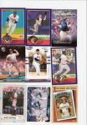
acquisition
Noun
The act of getting, earning, or acquiring something
His acquisition of old baseball cards became a profitable hobby.
Notes:
Input:
Present the word
State the part of speech
Read the definition and sentence
Point out the suffix on the word
Tell students to make sure they are familiar with how the word is used in the sentence
CFU:
Ask a student to give a paraphrase, example, or another sentence
Ask a different student to provide an example or another sentence using the word
Model:
If students are not able to do the CFU, provide a paraphrase and an example
Do this for any word that the students cannot paraphrase or give an example for.

Slide 4
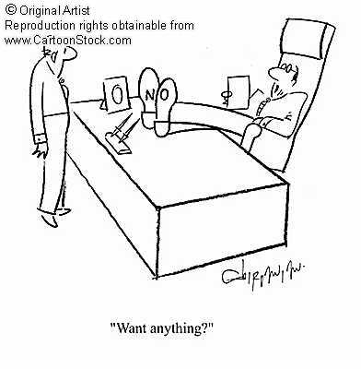
arrogant
Adjective
Conceited, giving oneself undeserved importance
His arrogant manner made everyone dislike him.
Notes:
Input:
For each of the following slides (with vocabulary words) have each student in turn:
Present the word
State the part of speech
Read the definition and sentence
Point out the suffix on the word
CFU:
Ask one of the other students to give a paraphrase of the definition, and another to provide an example or another sentence using the word.
Provide positive verbal feedback for each.
Restate the example or paraphrase if unclear how it relates (informal error correction)

Slide 5
derogate
Verb
To lessen, especially in authority
Her ability to appear in control was derogated by her timid nature and soft voice.
Notes:
Input:
Have students to identify the part of speech, read the definition and the sentence.
Clarify/restate any information that is unclear or inaccurate.
Point out the suffix on the word
CFU:
Ask a student to give a paraphrase of the definition
Ask a different student to provide an example or another sentence using the word

Slide 6
derogatory
Adjective
Belittling; discrediting; humiliating
Her derogatory comments made Lydia feel hurt and angry.
Notes:
Input:
Have students to identify the part of speech, read the definition and the sentence.
Clarify/restate any information that is unclear or inaccurate.
Point out the suffix on the word
CFU:
Ask a student to give a paraphrase of the definition
Ask a different student to provide an example or another sentence using the word

Slide 7
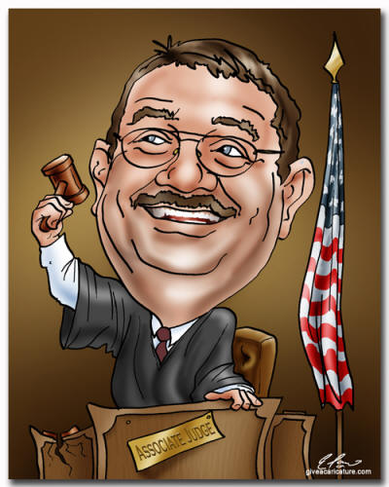
inquest
Noun
A legal investigation, especially involving a jury; a coroner’s investigation
The judge ordered an inquest to find out why the case had been mismanaged.
Notes:
Input:
Have students to identify the part of speech, read the definition and the sentence.
Clarify/restate any information that is unclear or inaccurate.
Point out the suffix on the word
CFU:
Ask a student to give a paraphrase of the definition
Ask a different student to provide an example or another sentence using the word

Slide 8
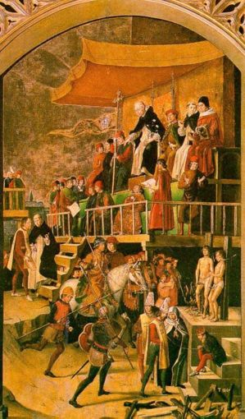
inquisition
Noun
An examination or investigation; an interrogation
The inquisition sought to find which citizens were loyal and which were not.

Slide 9
inquisitive
Adjective
Asking a lot of questions; extrememly curious
The inquisitive child asked her parents endless questions about everything.
Notes:
Input:
Have students to identify the part of speech, read the definition and the sentence.
Clarify/restate any information that is unclear or inaccurate.
Point out the suffix on the word
CFU:
Ask a student to give a paraphrase of the definition
Ask a different student to provide an example or another sentence using the word

Slide 10
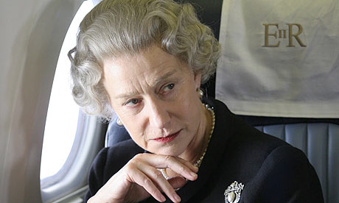
prerogative
Noun
A right or privilege, especially acquired through rank or class
It’s the queen’s prerogative to use all the royal residences and vehicles anytime she wants.
Notes:
Input:
Have students to identify the part of speech, read the definition and the sentence.
Clarify/restate any information that is unclear or inaccurate.
Point out the suffix on the word
CFU:
Ask a student to give a paraphrase of the definition
Ask a different student to provide an example or another sentence using the word

Slide 11
Quest
Noun
A search to find or obtain something; a crusade
Their quest for the sunken treasure ended in disappointment
Notes:
Input:
Have students to identify the part of speech, read the definition and the sentence.
Clarify/restate any information that is unclear or inaccurate.
Point out the suffix on the word
CFU:
Ask a student to give a paraphrase of the definition
Ask a different student to provide an example or another sentence using the word

Slide 12
questionable
Adjective
Of doubtful honesty or morality; disputable
His motives for offering help were questionable since he never did anything for others.
Notes:
Input:
Have students to identify the part of speech, read the definition and the sentence.
Clarify/restate any information that is unclear or inaccurate.
Point out the suffix on the word
CFU:
Ask a student to give a paraphrase of the definition
Ask a different student to provide an example or another sentence using the word

Slide 13
Practice Using the New Words!
Notes:
The independent practice that goes with this lesson will be introduced with this slide. As it is modified, I will not present it on the PPT or SB as that may cause confusion for the students who have the unmodified version. However, the following is how I will review the worksheet with the whole class:
Input:
Read the directions for the first section.
CFU: Ask if there are any questions
Guided Practice/Modeling:
Read the two words listed for the first question.Ask if the two words have the same meaning or different meanings. Model looking up the meaning for construe – note that assume the meaning is part of the definition. Have a student say that the words have the same meaning. Have the students circle same. Tell them they will do the same for 2-8.
CFU: ask if there are questions
Input: read the directions for the second section
Guided Practice: read the word for #9. Explain that they are to determine the meaning of port and then add the meaning of er. Give the example of teach + er…someone who teaches. Say to do the same thing for port, but that someone who ports doesn’t make sense, so they will need to look at the MEANING for port…to carry from one palace to another. A porter is someone who carries things from one place to another. Have students write in answer. Tell them to do the remaining two questions the same way.
CFU ask for questions.
Input: read the directions for the third question.
G.P. Do the first one together. Have three different students name one thing that is portable. Have students write in the answers.
CFU ask for questions
IP: have students complete the worksheet independently. CFU: circulate. Monitor for correct answers. If time allows when students are finished, go over the answers as class.
Closure: Remind students to review the words during the week. Remind them that if they learn the root words they will add more than just those ten words to their vocabulary. Have students turn in worksheets to appropriate areas.

