Slide 1
Vocabulary
Red Hot Root Words

Slide 2
ROOTS
Root Words Meaning Words You Already Know
Labor work labor
oper work operate
Techni skill technique
Trib pay, bestow contribute
Notes:
Input:
Present the root words” Explain their meanings.
CFU:
Ask students to tell you another word with fore
Repeat with other root words.

Slide 3
collaborate
Verb
To work with other people, especially on literary or scientific work; to cooperate with the enemy
The scientists decided to collaborate and submit their findings together.
Notes:
Input:
Present the word
State the part of speech
Read the definition and sentence
Point out the suffix on the word
Tell students to make sure they are familiar with how the word is used in the sentence
CFU:
Ask a student to give a paraphrase, example, or another sentence
Ask a different student to provide an example or another sentence using the word
Model:
If students are not able to do the CFU, provide a paraphrase and an example
Do this for any word that the students cannot paraphrase or give an example for.

Slide 4
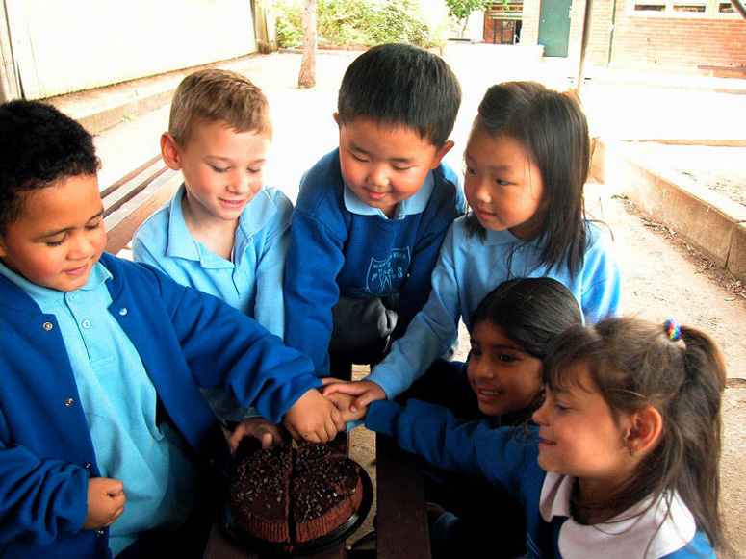
cooperate
Verb
To work together to accomplish something
If you cooperate with your partner, you will be able to finish the task quickly.
Notes:
Input:
For each of the following slides (with vocabulary words) have each student in turn:
Present the word
State the part of speech
Read the definition and sentence
Point out the suffix on the word
CFU:
Ask one of the other students to give a paraphrase of the definition, and another to provide an example or another sentence using the word.
Provide positive verbal feedback for each.
Restate the example or paraphrase if unclear how it relates (informal error correction)

Slide 5
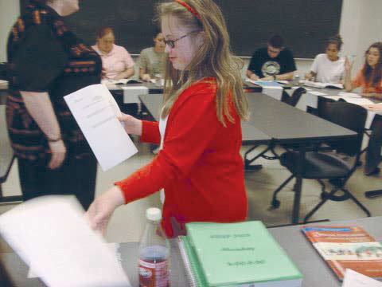
distribute
Verb
To divide or give out in two or more portions; to spread out
The teacher asked her aide to distribute one science kit to every two students.
Notes:
Input:
Have students to identify the part of speech, read the definition and the sentence.
Clarify/restate any information that is unclear or inaccurate.
Point out the suffix on the word
CFU:
Ask a student to give a paraphrase of the definition
Ask a different student to provide an example or another sentence using the word

Slide 6
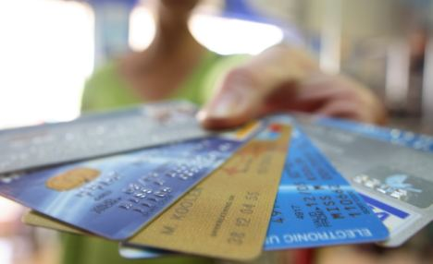
laborious
Adjective
Hard working; requiring a lot of labor; not easy
She had the laborious task of picking up all the cards and putting them in alphabetical order.
Notes:
Input:
Have students to identify the part of speech, read the definition and the sentence.
Clarify/restate any information that is unclear or inaccurate.
Point out the suffix on the word
CFU:
Ask a student to give a paraphrase of the definition
Ask a different student to provide an example or another sentence using the word

Slide 7
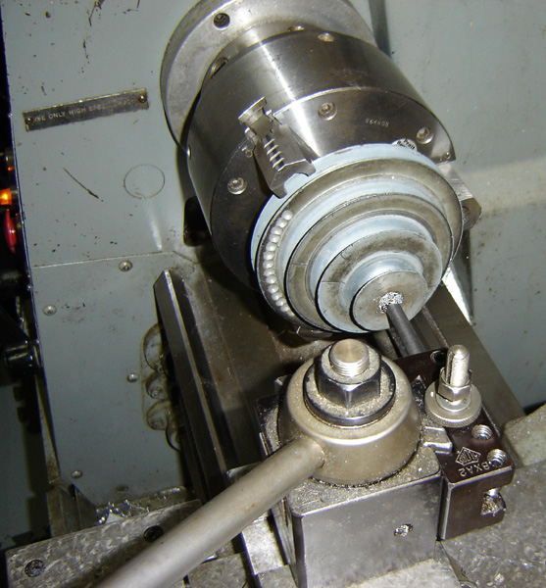
operable
Adjective
Capable of being put into use; in working condition
Once he put a new motor in the machine, it was completely operable again.

Slide 8
pyrotechnics
Noun
The art of making or displaying fireworks
The Chinese celebrate the new year with pyrotechnics.
Notes:
Input:
Have students to identify the part of speech, read the definition and the sentence.
Clarify/restate any information that is unclear or inaccurate.
Point out the suffix on the word
CFU:
Ask a student to give a paraphrase of the definition
Ask a different student to provide an example or another sentence using the word

Slide 9
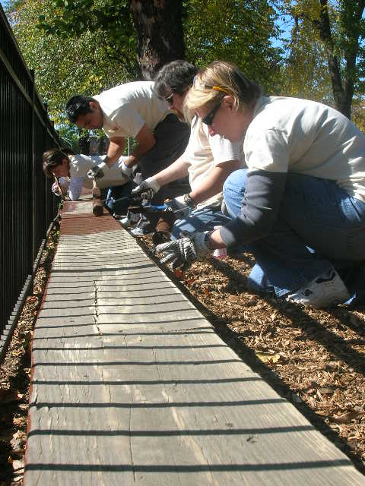
retribution
Noun
Punishment for evil doing or reward for good works
His retribution for the crime was to do 100 hours of community service.
Notes:
Input:
Have students to identify the part of speech, read the definition and the sentence.
Clarify/restate any information that is unclear or inaccurate.
Point out the suffix on the word
CFU:
Ask a student to give a paraphrase of the definition
Ask a different student to provide an example or another sentence using the word

Slide 10
technician
Noun
One with great skill in a particular area
Her skill in playing the violin was a combination of being a skilled technician and gifted artist.
Notes:
Input:
Have students to identify the part of speech, read the definition and the sentence.
Clarify/restate any information that is unclear or inaccurate.
Point out the suffix on the word
CFU:
Ask a student to give a paraphrase of the definition
Ask a different student to provide an example or another sentence using the word

Slide 11
technology
Noun
The science of practical or industrial arts or applied science
Technology has developed many conveniences that make our lives easier.
Notes:
Input:
Have students to identify the part of speech, read the definition and the sentence.
Clarify/restate any information that is unclear or inaccurate.
Point out the suffix on the word
CFU:
Ask a student to give a paraphrase of the definition
Ask a different student to provide an example or another sentence using the word

Slide 12
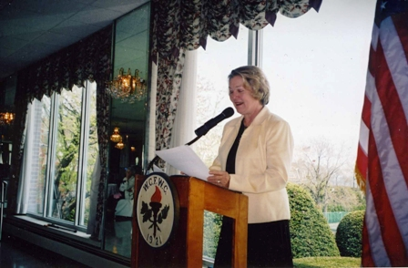
tribute
Noun
Money paid to another country or leader for protection; a gift or statement that shows respect or gratitude
Her speech paid tribute to all the teachers who had helped her earn the award.
Notes:
Input:
Have students to identify the part of speech, read the definition and the sentence.
Clarify/restate any information that is unclear or inaccurate.
Point out the suffix on the word
CFU:
Ask a student to give a paraphrase of the definition
Ask a different student to provide an example or another sentence using the word

Slide 13
Practice Using the New Words!
Notes:
The independent practice that goes with this lesson will be introduced with this slide. As it is modified, I will not present it on the PPT or SB as that may cause confusion for the students who have the unmodified version. However, the following is how I will review the worksheet with the whole class:
Input:
Read the directions for the first section.
CFU: Ask if there are any questions
Guided Practice/Modeling:
Read the two words listed for the first question.Ask if the two words have the same meaning or different meanings. Model looking up the meaning for construe – note that assume the meaning is part of the definition. Have a student say that the words have the same meaning. Have the students circle same. Tell them they will do the same for 2-8.
CFU: ask if there are questions
Input: read the directions for the second section
Guided Practice: read the word for #9. Explain that they are to determine the meaning of port and then add the meaning of er. Give the example of teach + er…someone who teaches. Say to do the same thing for port, but that someone who ports doesn’t make sense, so they will need to look at the MEANING for port…to carry from one palace to another. A porter is someone who carries things from one place to another. Have students write in answer. Tell them to do the remaining two questions the same way.
CFU ask for questions.
Input: read the directions for the third question.
G.P. Do the first one together. Have three different students name one thing that is portable. Have students write in the answers.
CFU ask for questions
IP: have students complete the worksheet independently. CFU: circulate. Monitor for correct answers. If time allows when students are finished, go over the answers as class.
Closure: Remind students to review the words during the week. Remind them that if they learn the root words they will add more than just those ten words to their vocabulary. Have students turn in worksheets to appropriate areas.

