Slide 1
Vocabulary
Red Hot Root Words

Slide 2
ROOTS
Root Words Meaning Words You Already Know
Magn, magni great magnify
Maxi large, great maximum
micro small microscope
Min small miniature
Notes:
Input:
Present the root words” Explain their meanings.
CFU:
Ask students to tell you another word with fore
Repeat with other root words.

Slide 3
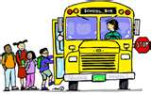
Diminutive
Adjective
Smaller than usual; tiny
The diminutive kindergartner was afraid to get on the bus with the larger students.
Notes:
Input:
Present the word
State the part of speech
Read the definition and sentence
Point out the suffix on the word
Tell students to make sure they are familiar with how the word is used in the sentence
CFU:
Ask a student to give a paraphrase, example, or another sentence
Ask a different student to provide an example or another sentence using the word
Model:
If students are not able to do the CFU, provide a paraphrase and an example
Do this for any word that the students cannot paraphrase or give an example for.

Slide 4
magnanimous
Adjective
Generous; not selfish; forgiving
The magnanimous neighbor forgave the boys for breaking her window with their ball.
Notes:
Input:
For each of the following slides (with vocabulary words) have each student in turn:
Present the word
State the part of speech
Read the definition and sentence
Point out the suffix on the word
CFU:
Ask one of the other students to give a paraphrase of the definition, and another to provide an example or another sentence using the word.
Provide positive verbal feedback for each.
Restate the example or paraphrase if unclear how it relates (informal error correction)

Slide 5
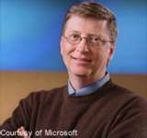
magnate
Noun
A person of great importance and with great influence
Bill Gates, owner of Microsoft, is a magnate in the computer industry.
Notes:
Input:
Have students to identify the part of speech, read the definition and the sentence.
Clarify/restate any information that is unclear or inaccurate.
Point out the suffix on the word
CFU:
Ask a student to give a paraphrase of the definition
Ask a different student to provide an example or another sentence using the word

Slide 6
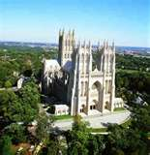
magnificence
Noun
Richness; splendid appearance; beauty
The tourists stood in awe at the magnificence of the cathedral.
Notes:
Input:
Have students to identify the part of speech, read the definition and the sentence.
Clarify/restate any information that is unclear or inaccurate.
Point out the suffix on the word
CFU:
Ask a student to give a paraphrase of the definition
Ask a different student to provide an example or another sentence using the word

Slide 7
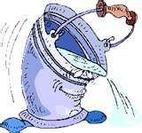
Maximal
Adjective
The greatest possible amount or size
The maximal amount this bucket can hold is two liters.

Slide 8
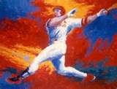
maximize
Verb
To increase to the greatest possible amount
To maximize his chances for a home run, he hit the ball into the left field.
Notes:
Input:
Have students to identify the part of speech, read the definition and the sentence.
Clarify/restate any information that is unclear or inaccurate.
Point out the suffix on the word
CFU:
Ask a student to give a paraphrase of the definition
Ask a different student to provide an example or another sentence using the word

Slide 9
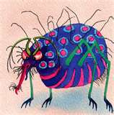
microbe
Noun
A very small living thing, especially bacteria; a germ
A small microbe that was found in the drinking water was responsible for the illness.
Notes:
Input:
Have students to identify the part of speech, read the definition and the sentence.
Clarify/restate any information that is unclear or inaccurate.
Point out the suffix on the word
CFU:
Ask a student to give a paraphrase of the definition
Ask a different student to provide an example or another sentence using the word

Slide 10
microphone
Noun
A device that changes sound waves to electrical impulses so they can be recorded or amplified.
You’ll need to turn the volume down if you don’t want to get a screeching noise through the microphone.
Notes:
Input:
Have students to identify the part of speech, read the definition and the sentence.
Clarify/restate any information that is unclear or inaccurate.
Point out the suffix on the word
CFU:
Ask a student to give a paraphrase of the definition
Ask a different student to provide an example or another sentence using the word

Slide 11
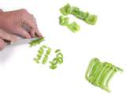
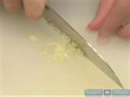
mince
Verb
To cut into small pieces
Mince the vegetable before you put them in the water to boil.
Notes:
Input:
Have students to identify the part of speech, read the definition and the sentence.
Clarify/restate any information that is unclear or inaccurate.
Point out the suffix on the word
CFU:
Ask a student to give a paraphrase of the definition
Ask a different student to provide an example or another sentence using the word

Slide 12
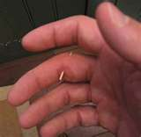
minuscule
Adjective
Very small; tiny
The sliver was so minuscule that it was nearly impossible to take it out of her finger.
Notes:
Input:
Have students to identify the part of speech, read the definition and the sentence.
Clarify/restate any information that is unclear or inaccurate.
Point out the suffix on the word
CFU:
Ask a student to give a paraphrase of the definition
Ask a different student to provide an example or another sentence using the word

Slide 13
Practice Using the New Words!
Notes:
The independent practice that goes with this lesson will be introduced with this slide. As it is modified, I will not present it on the PPT or SB as that may cause confusion for the students who have the unmodified version. However, the following is how I will review the worksheet with the whole class:
Input:
Read the directions for the first section.
CFU: Ask if there are any questions
Guided Practice/Modeling:
Read the two words listed for the first question.Ask if the two words have the same meaning or different meanings. Model looking up the meaning for construe – note that assume the meaning is part of the definition. Have a student say that the words have the same meaning. Have the students circle same. Tell them they will do the same for 2-8.
CFU: ask if there are questions
Input: read the directions for the second section
Guided Practice: read the word for #9. Explain that they are to determine the meaning of port and then add the meaning of er. Give the example of teach + er…someone who teaches. Say to do the same thing for port, but that someone who ports doesn’t make sense, so they will need to look at the MEANING for port…to carry from one palace to another. A porter is someone who carries things from one place to another. Have students write in answer. Tell them to do the remaining two questions the same way.
CFU ask for questions.
Input: read the directions for the third question.
G.P. Do the first one together. Have three different students name one thing that is portable. Have students write in the answers.
CFU ask for questions
IP: have students complete the worksheet independently. CFU: circulate. Monitor for correct answers. If time allows when students are finished, go over the answers as class.
Closure: Remind students to review the words during the week. Remind them that if they learn the root words they will add more than just those ten words to their vocabulary. Have students turn in worksheets to appropriate areas.

