Slide 1
Red Hot Root Words
Lesson 1

Slide 2
What Do You Notice?
Submarine
Subconscious
Subdue
Subjugate
Subterranean
Transportation
Transplant
Transcribe
Transfer
Transluscent

Slide 3
SUB
Below, under
Submarine

Slide 4

TRANS
Across, over
Transport

Slide 5
Subconscious
Noun
The part of the mind’s function of which you are not aware
Something in my subconscious told me that things were not quite right.

Slide 6

Subdue
Verb
To conquer or bring under control
The lion tamer was able to subdue the agitated animal.

Slide 7
Subjugate
Verb
To conquer or bring under control by force
The military tried to subjugate the people who were rioting in the streets.

Slide 8

Subsidize
Verb
To furnish money or to assist with the payment of money
Her parents had to subsidize her expenses while she was in college.

Slide 9
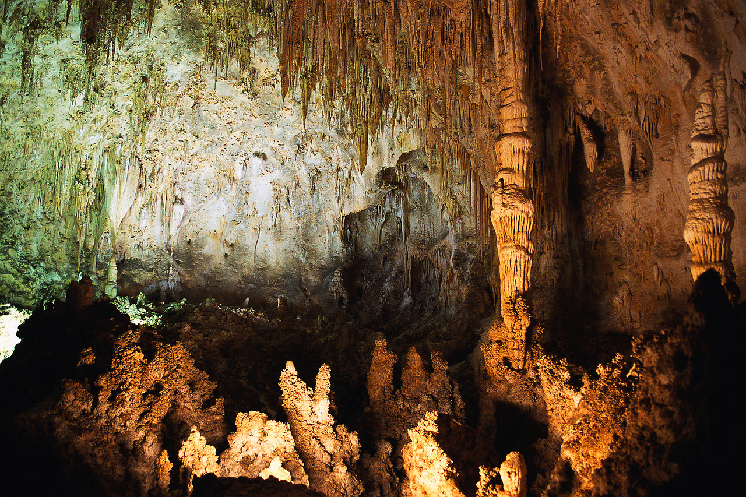
Subterranean
Adjective
Beneath the earth’s surface
The subterranean cave took us down 500 meters below the cave’s entrance.

Slide 10

Transcribe
Verb
To make a written copy
The executive asked her secretary to transcribe the notes from the meeting.

Slide 11
Transfer
Verb
To carry or send from one person or place to another
The unhappy student asked to be transferred to a different gym class.

Slide 12
Transform
Verb
To change in form or appearance
The fairy godmother transformed the pumpkin into a carriage.

Slide 13
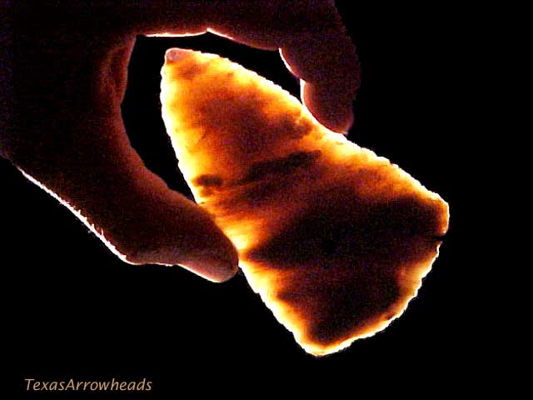
Translucent
Adjective
Permitting some light to pass through but giving an unclear image
The curtains were transparent, allowing only a small amount of light to show through.

Slide 14
Transplant
Verb
To plant in another place
I transplanted my entire flower garden to a spot where it could get more sun.

Slide 15
.

