Slide 1
Vocabulary
Red Hot Root Words

Slide 2
Prefixes
PREFIXES Meaning Words You Already Know
Ab, abs away, from abolish, absent
Apo away, from apostrophe, apology
Notes:
Input:
Present the root words” Explain their meanings.
CFU:
Ask students to tell you another word with fore
Repeat with other root words.

Slide 3
abandon
Verb
To leave or give up completely; to discontinue
I am just going to abandon this science project and start an entirely new one.
Notes:
Input:
Present the word
State the part of speech
Read the definition and sentence
Point out the suffix on the word
Tell students to make sure they are familiar with how the word is used in the sentence
CFU:
Ask a student to give a paraphrase, example, or another sentence
Ask a different student to provide an example or another sentence using the word
Model:
If students are not able to do the CFU, provide a paraphrase and an example
Do this for any word that the students cannot paraphrase or give an example for.

Slide 4
abdicate
Verb
Give up power, authority or the throne
The king had to abdicate his throne and turn over power to his daughter, Princess Leah.
Notes:
Input:
For each of the following slides (with vocabulary words) have each student in turn:
Present the word
State the part of speech
Read the definition and sentence
Point out the suffix on the word
CFU:
Ask one of the other students to give a paraphrase of the definition, and another to provide an example or another sentence using the word.
Provide positive verbal feedback for each.
Restate the example or paraphrase if unclear how it relates (informal error correction)

Slide 5
abduct
Verb
To take away by force, kidnap
The men abducted the heiress and held her for a million dollar ransom.
Notes:
Input:
Have students to identify the part of speech, read the definition and the sentence.
Clarify/restate any information that is unclear or inaccurate.
Point out the suffix on the word
CFU:
Ask a student to give a paraphrase of the definition
Ask a different student to provide an example or another sentence using the word

Slide 6
abnormal
Adjective
Not typical, average or normal
Needing to sleep with a nightlight on each night is abnormal behavior for someone his age.
Notes:
Input:
Have students to identify the part of speech, read the definition and the sentence.
Clarify/restate any information that is unclear or inaccurate.
Point out the suffix on the word
CFU:
Ask a student to give a paraphrase of the definition
Ask a different student to provide an example or another sentence using the word

Slide 7
aboriginal
noun
The original inhabitants of a country
Though the aboriginals had lived in the area for generations, they owned very little property.

Slide 8
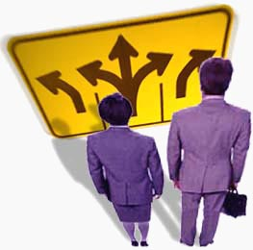
absolute
Adjective
Without restraint, not dependent on anything
His decision was absolute; there was no arguing with him.
Notes:
Input:
Have students to identify the part of speech, read the definition and the sentence.
Clarify/restate any information that is unclear or inaccurate.
Point out the suffix on the word
CFU:
Ask a student to give a paraphrase of the definition
Ask a different student to provide an example or another sentence using the word

Slide 9
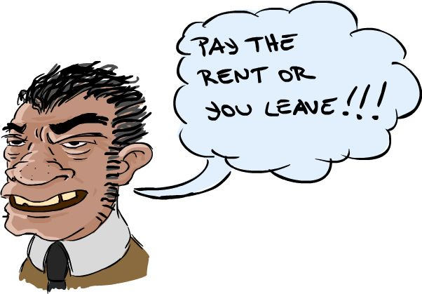
absolve
Verb
To free from blame, debt or responsibility
The kindly landlord absolved the poor tenant of all the past-due rent he owed.
Notes:
Input:
Have students to identify the part of speech, read the definition and the sentence.
Clarify/restate any information that is unclear or inaccurate.
Point out the suffix on the word
CFU:
Ask a student to give a paraphrase of the definition
Ask a different student to provide an example or another sentence using the word

Slide 10
abstain
Verb
To voluntarily refrain from
I am trying to abstain from eating chocolate.
Notes:
Input:
Have students to identify the part of speech, read the definition and the sentence.
Clarify/restate any information that is unclear or inaccurate.
Point out the suffix on the word
CFU:
Ask a student to give a paraphrase of the definition
Ask a different student to provide an example or another sentence using the word

Slide 11
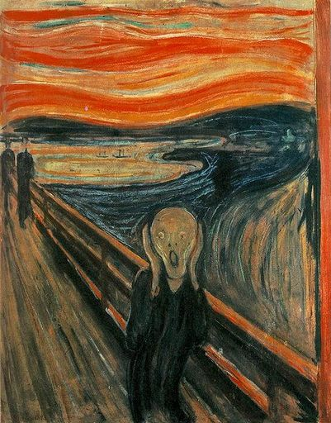
abstract
Adjective
Not concrete or related to specific things; not easy to understand
His lecture seemed very abstract and not related to real life.
Notes:
Input:
Have students to identify the part of speech, read the definition and the sentence.
Clarify/restate any information that is unclear or inaccurate.
Point out the suffix on the word
CFU:
Ask a student to give a paraphrase of the definition
Ask a different student to provide an example or another sentence using the word

Slide 12
apogee
Noun
The point in the moon’s or a satellite’s orbit when it is farthest from the earth or the body it orbits
The opposite of the moon’s apogee is its perigee.
Notes:
Input:
Have students to identify the part of speech, read the definition and the sentence.
Clarify/restate any information that is unclear or inaccurate.
Point out the suffix on the word
CFU:
Ask a student to give a paraphrase of the definition
Ask a different student to provide an example or another sentence using the word

Slide 13
Practice Using the New Words!
Notes:
The independent practice that goes with this lesson will be introduced with this slide. As it is modified, I will not present it on the PPT or SB as that may cause confusion for the students who have the unmodified version. However, the following is how I will review the worksheet with the whole class:
Input:
Read the directions for the first section.
CFU: Ask if there are any questions
Guided Practice/Modeling:
Read the two words listed for the first question.Ask if the two words have the same meaning or different meanings. Model looking up the meaning for construe – note that assume the meaning is part of the definition. Have a student say that the words have the same meaning. Have the students circle same. Tell them they will do the same for 2-8.
CFU: ask if there are questions
Input: read the directions for the second section
Guided Practice: read the word for #9. Explain that they are to determine the meaning of port and then add the meaning of er. Give the example of teach + er…someone who teaches. Say to do the same thing for port, but that someone who ports doesn’t make sense, so they will need to look at the MEANING for port…to carry from one palace to another. A porter is someone who carries things from one place to another. Have students write in answer. Tell them to do the remaining two questions the same way.
CFU ask for questions.
Input: read the directions for the third question.
G.P. Do the first one together. Have three different students name one thing that is portable. Have students write in the answers.
CFU ask for questions
IP: have students complete the worksheet independently. CFU: circulate. Monitor for correct answers. If time allows when students are finished, go over the answers as class.
Closure: Remind students to review the words during the week. Remind them that if they learn the root words they will add more than just those ten words to their vocabulary. Have students turn in worksheets to appropriate areas.

