Slide 1
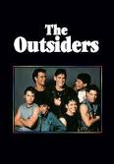
What Is Theme?
What makes a story linger in our hearts and minds long after we’ve read it? Often it is the idea on which the story is built—its theme.

Slide 2
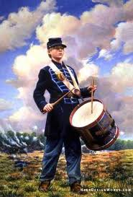
What Is Theme?
Theme—the central idea, message, or insight about life or human behavior that a story reveals
Charles-it is always best to be honest from the start, no matter of the consequences
Drummer Boy of Shiloh-no matter how small your job/role may seem, it could be very important to the success of others

Slide 3
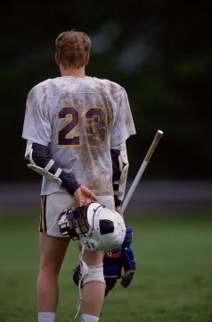
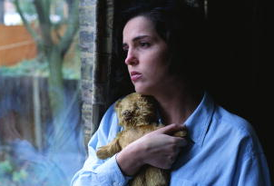
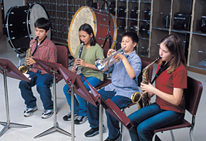
What Is Theme?
In most stories, the theme is not stated directly. Instead, it is revealed to us through the characters’ experiences.
[End of Section]

Slide 4
Universal Themes
Different writers from different cultures often express similar themes.
A theme is a generalization about life or human nature.
Certain types of experiences are common to all people everywhere.

Slide 5
Universal Themes
Universal themes
come up again and again in literature
deal with basic human concerns—good and evil, life and death, love and loss
shine a light on our common experiences
can help guide us through our lives

Slide 6
Finding the Theme
Keep the following guidelines in mind when you want to find and state the theme of a work.
The theme is not the same thing as the subject.
The subject is simply the topic. It can be stated in a single word, such as loyalty.
The theme makes some revelation about the subject and should be expressed in a sentence: “Loyalty to a leader is not always noble.”

Slide 7
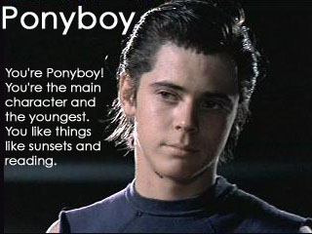
Finding the Theme
Writers often express theme through what their characters learn.
Does the main character change?
Does a character realize something he or she did not know before?

Slide 8
Finding the Theme
Conflict helps reveal theme.
What is the conflict, or struggle between opposing forces, that the main character faces?
How is the conflict resolved?
Conflict
Resolution
Theme
Two friends find a wallet. One friend wants to return it to the owner; the other wants to keep it.
They return the wallet and share a small reward.
People are often rewarded for making the right moral decision.

Slide 9
Finding the Theme
Sometimes the title gives clues.
Does the title have a special meaning?
Does it point to the theme?
The theme applies to the entire work.
Test your statement of the theme. Does it apply to the whole work, not just to parts of it?

Slide 10
Finding the Theme
There is no single way to state the theme.
People may express the same theme in different words.
There may be different opinions about what the main theme is.
The most meaningful literary works often have more than one theme.

Slide 11
PRACTICE Think about The Outsiders and the impact it had on you. Then, use the questions below to help you figure out the story’s theme. How the main character changes: How the conflict is resolved: What the title suggests:

Slide 12
The End

