Slide 1
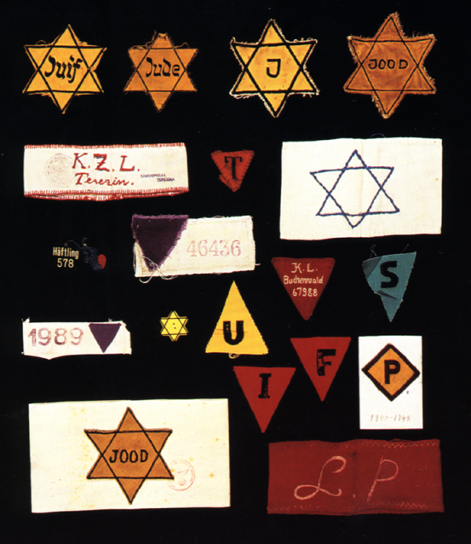
The Holocaust
January 30, 1933 to May 8, 1945

Slide 2
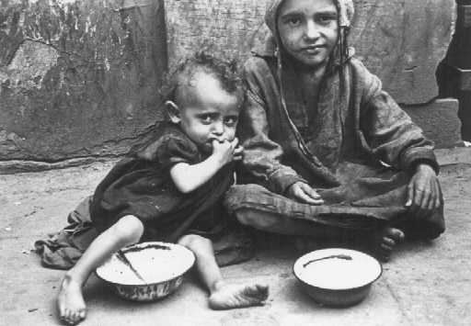
Definitions
Holocaust: an act of mass destruction and loss of life (especially in war or by fire); "a completely burned sacrifice”
The Nuremberg Laws: constitutional laws provided for the legal and social separation of German Jews from German non-Jews
Ghettos: A part of a city set aside by the Nazis to contain only Jews, which was heavily guarded and lacking in food, water, heat, housing, and health care

Slide 3
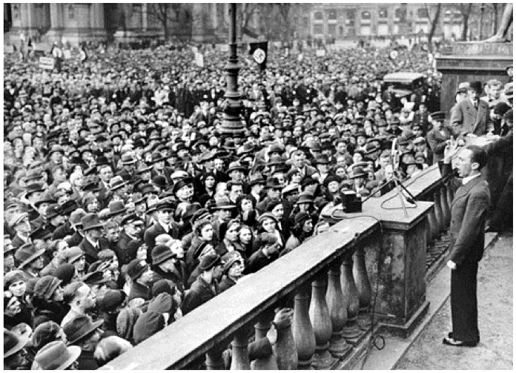
Adolf Hitler (1889-1945)
leader of the National Socialist (Nazi) Party
Appointed chancellor of a coalition cabinet in 1933—immediately set up a dictatorship
On April 30, 1945-- committed suicide rather than be captured alive

Slide 4
Death Totals
6 million Jews
1.5 million children under 12
These groups make up 5 of the 11 million lives lost
Jehovah’s Witnesses
Poles (Polish, Roman Catholics)
Homosexuals
Sinti & Roma (“Gypsies”)
Handicapped
11 MILLION KILLED

Slide 5
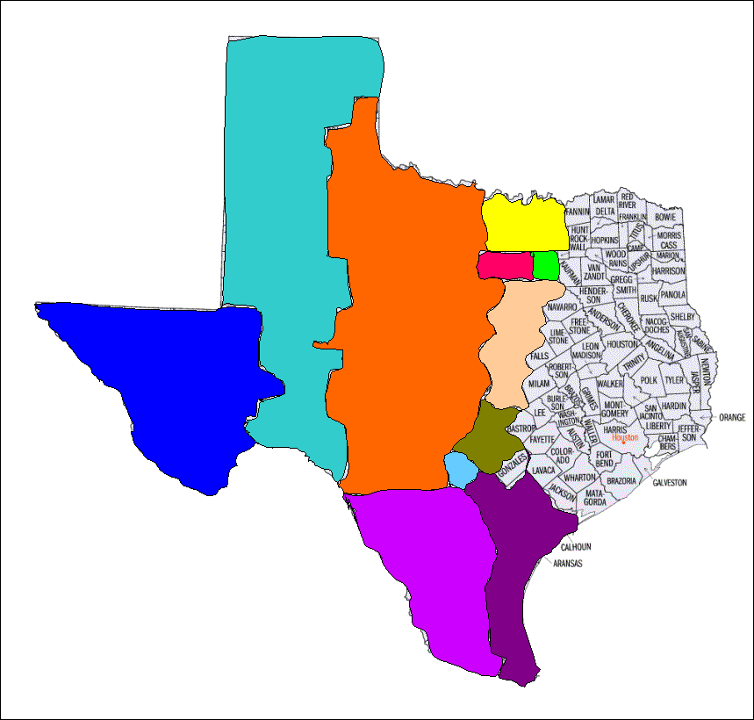
11 Million People Killed during the Holocaust

Slide 6
Timeline of the Holocaust
1933:
Hitler is appointed chancellor of Germany
The first concentration camp was built (Dachau)
Nazis boycott Jewish businesses
Nazis outlaw all other political parties in Germany
1934:
Hitler becomes Führer after German President von Hindenburg dies
“He alone, who owns the youth, gains the future.” –Adolf Hitler

Slide 7
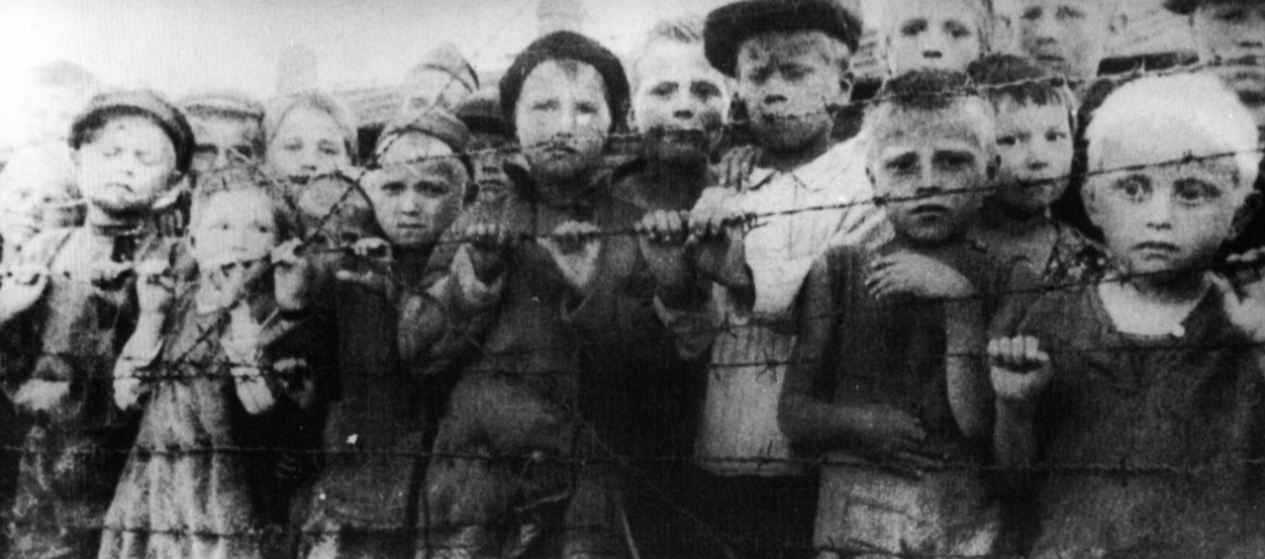
1935:
German Parliament passes Nuremberg Laws stripping Jewish Germans of many rights
“You have no right to live among us as Jews.”

Slide 8
1936 Olympics German citizens salute Adolf Hitler at the 1936 Olympics in Berlin

Slide 9
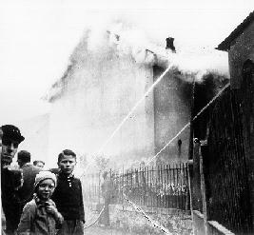
1938:
Nazi troops enter Austria (200,000 Jews)
Kristallnacht (“The Night of Broken Glass”)-- A massive, coordinated attack on Jews
Many Jews are sent to concentration camps after the attack

Slide 10
1939: -Nazi troops seize Czechoslovakia (Jewish pop. 350,000) -Jews lose rights as tenants and are relocated into Jewish houses -Nazis invade Poland (Jewish pop. 3.35 million, the largest in Europe) -England and France declare war on Germany -Yellow stars required to be worn by Polish Jews over age 10
Hitler's Speech threatening Jews

Slide 11
Entrance to Auschwitz: “WORK WILL SET YOU FREE” 1940: Nazis choose the town of Oswiecim (Auschwitz) in Poland near Krakow as site of new concentration camp.

Slide 12
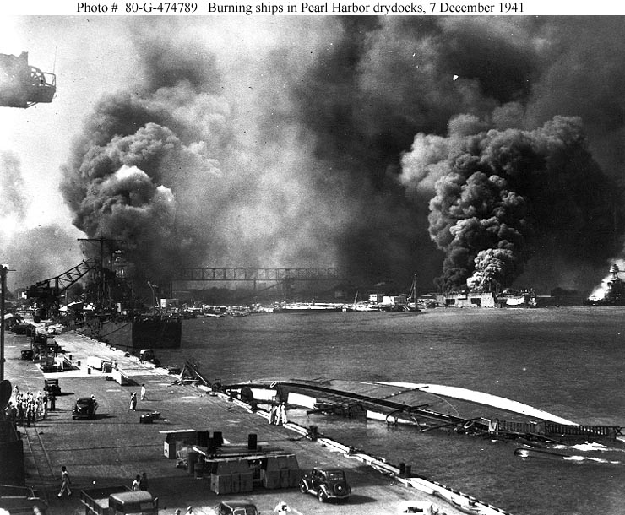
Dec 7, 1941 - Japanese attack United States at Pearl Harbor. The next day the U.S. and Britain declare war on Japan.
Dec 11, 1941 - Hitler declares war on the United States. Roosevelt then declares war on Germany saying, "Never before has there been a greater challenge to life, liberty and civilization." The U.S.A. then enters the war in Europe and will concentrate nearly 90 percent of its military resources to defeat Hitler.

Slide 13
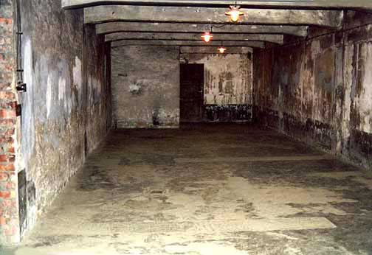
1942:
Mass killings of Jews by gas chambers at Auschwitz-Birkenau
SS Einsatzgruppe Reports a tally of 229,052 Jews killed

Slide 14
1943
The number of Jews killed by SS Einsatzgruppen passes one million
Allies land in Sicily.
Continuation of Jews being sent to concentration camps

Slide 15
As the end nears….
1945:
As the Allies advance, the Nazis conduct death marches of concentration camp inmates away from outlying areas.
Jan 27, 1945 - Soviet troops liberate Auschwitz. By this time, an estimated 2,000,000 persons, including 1,500,000 Jews, have been murdered there.
Approximately 40,000 prisoners freed at Bergen-Belsen
1944:
June 6, 1944 - D-Day: Allied landings in Normandy
Soviet troops liberate first concentration camp at Majdanek where over 360,000 had been murdered.
Oct 30, 1944 - Last use of gas chambers at Auschwitz.

Slide 16
“In Germany they first came for the Communists, and I didn’t speak up because I wasn’t a Communist. Then they came for the Jews, and I didn’t speak up because I wasn’t a Jew. Then they came for the trade unionists, and I didn’t speak up because I wasn’t a trade unionist. Then they came for the Catholics, and I didn’t speak up because I was a Protestant. Then they came for me – and by that time no one was left to speak up.”
Reverend Martin Niemoeller,
Protestant minister, Germany, and concentration camp survivor

Slide 17
