Slide 1
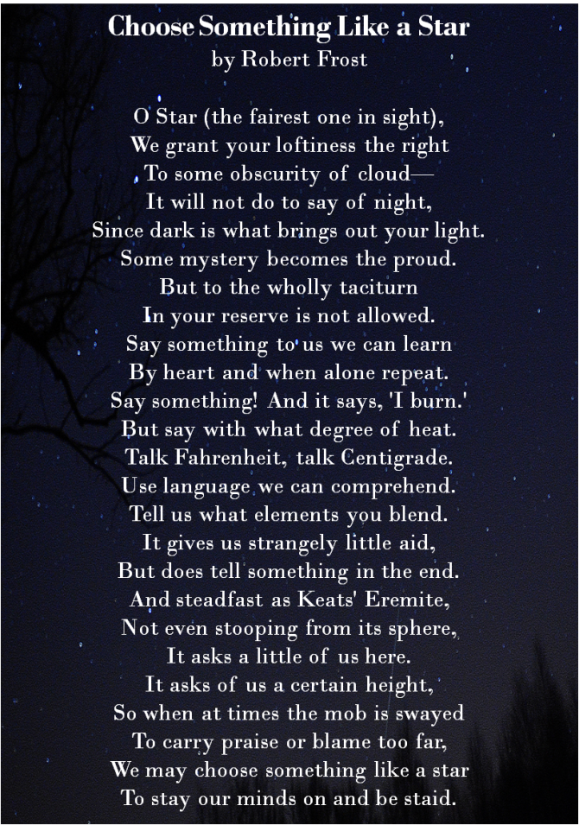
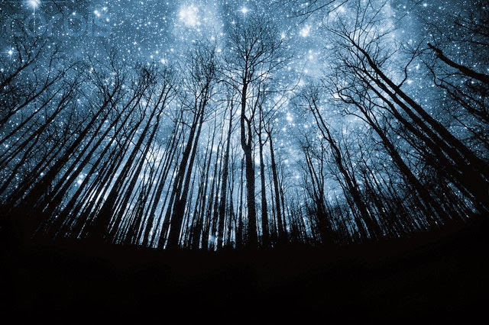
Choose Something Like a Star
Stars are an amazing creation, and we should all be influenced by their intricacies.

Slide 2
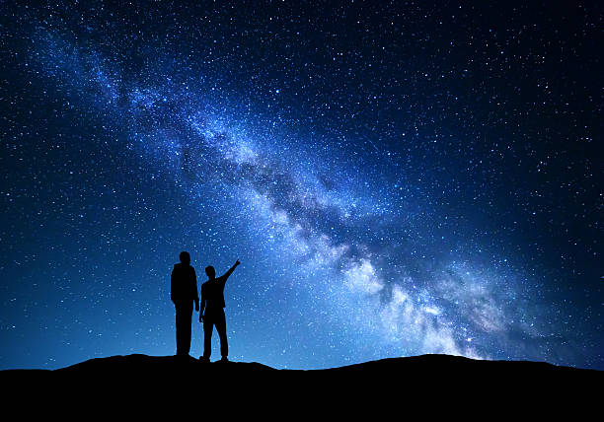
Poem Summary
Robert Frost is looking to the stars for guidance in life. He wants an answer during darkness or bad times. He states, “Use a language we can comprehend.” To me this conveys that he wants an answer from the stars. He also states that it will provide “…little aid, but does tell something in the end.” He has faith that the stars will come through to guide him.

Slide 3
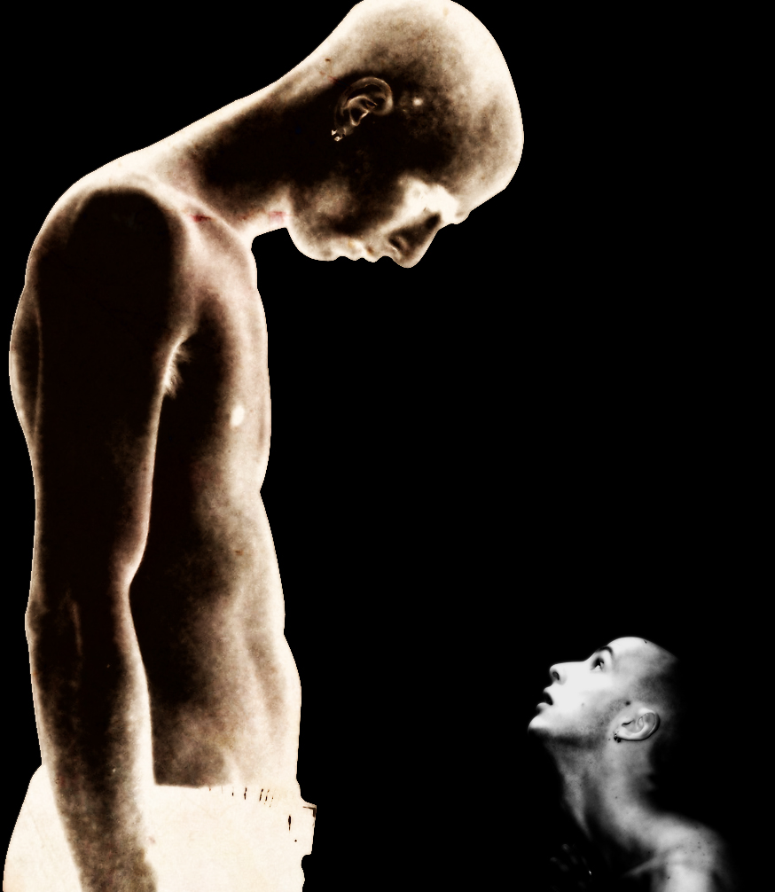
Describing the Poem
The poem is describing the importance of the stars.
The stars may be compared to a god or a leader.
The author wants people to know that there can always be something positive in life to look up to.
The poem could be taking place during dark times in Frost’s life.

Slide 4
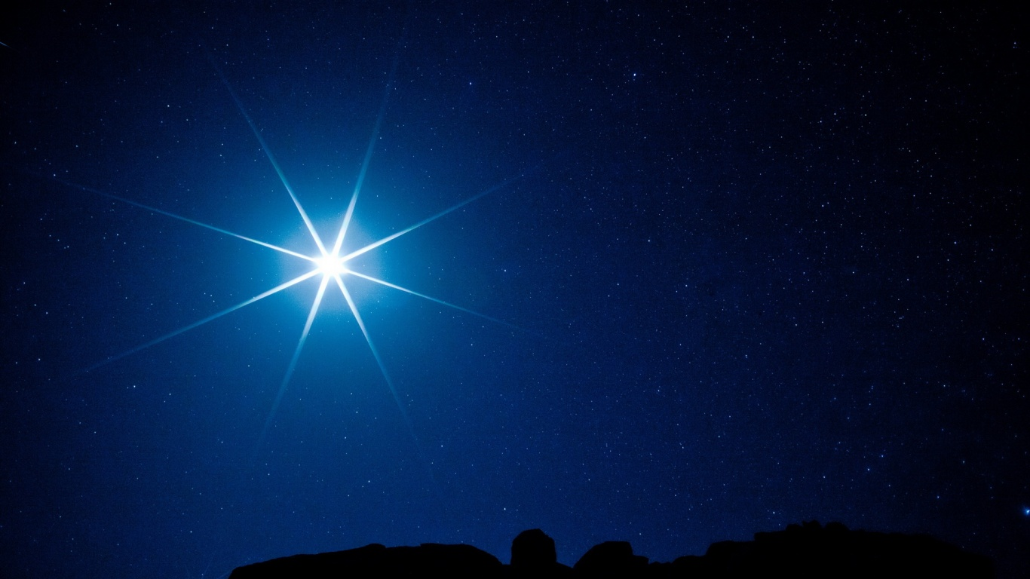
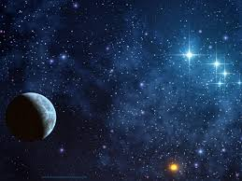
The poem is happening within Robert Frost’s thoughts and feelings.
I think his attitude may be hopeful, despaired and possibly lost.
The beginning is more information being told about the stars and the end switches to the effects that the stars have from their detail and formula.
Description continued

Slide 5
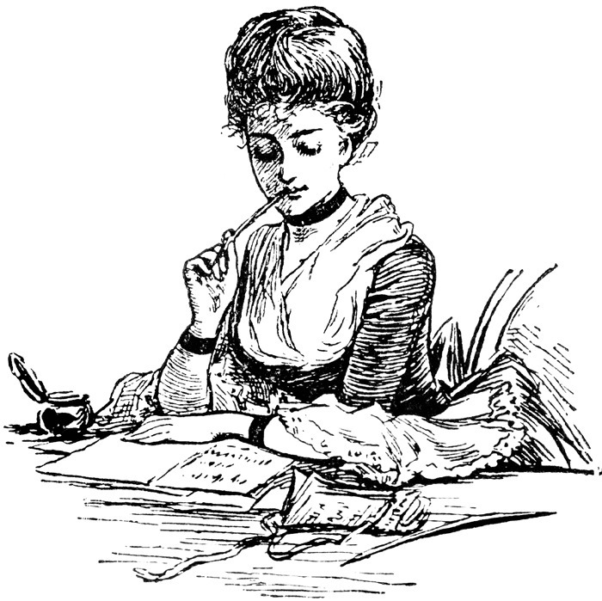
Poetic Devices in “Choose Something Like a Star”
Simile’s- (the title) Choose Something Like a Star. “And Steadfast as Keats’ Eremite…”
Personification- “Say something! And it says ‘I burn.’’’
Tone- The author uses a hopeful and purposeful tone.
Imagery- “…not even stooping from it’s sphere…”

Slide 6
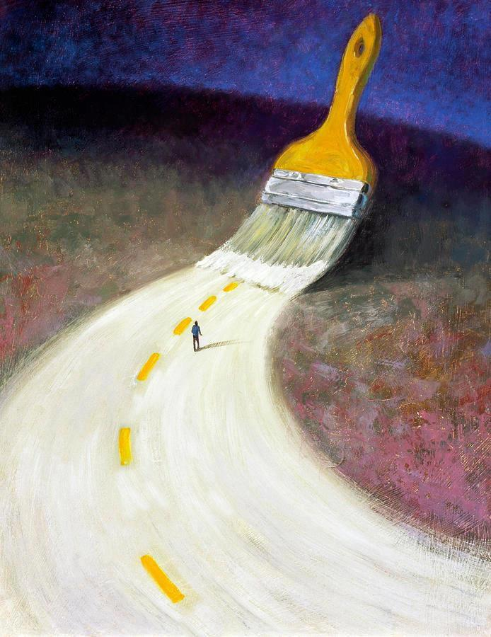
Theme
You should devote yourself to following a good path when life may be pushing you the other way. Keep yourself distracted by a good message.

Slide 7
Poem Analysis
My poem is “Choose Something Like a Star,” by Robert Frost. When he chose the title, Frost was in need of guidance and something to look up to.
The meaning of this poem is to follow the path of the stars and look up to them. They are bright when it is dark, which means they can overcome any weakness. When things may be hard during your life or around the world, let the stars distract you by shining their powerful light into your heart.
Robert Frost has definitely overcome his weaknesses through all of the hardships he had to face.

Slide 8
Frost’s Experiences
Lost multiple family members i.e. father and child
Attempted multiple careers that did not interest him

Slide 9
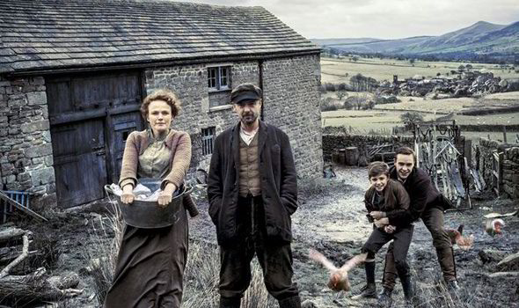
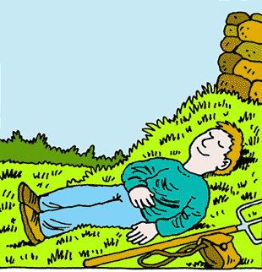
Conditions in Frost’s Country
Poverty
Moved to England due to failure at farming.

Slide 10
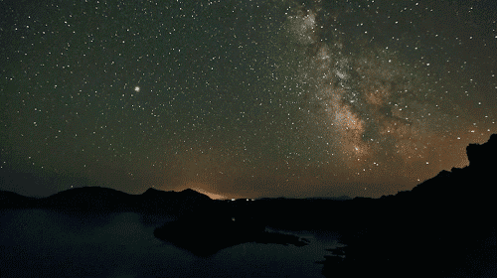
Every star chooses to shine, giving us guidance with their light.

