Slide 1
This
IS
Jeopardy

Slide 3
Characters

Slide 4
Conflict

Slide 5
Relationships

Slide 6
Miscellaneous

Slide 7
Setting

Slide 8
Quotes

Slide 9
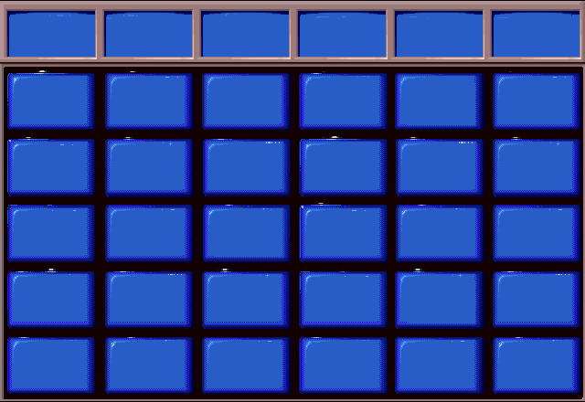
Characters
Conflicts
Relationships
Miscellaneous
Setting
Quotes
$100
$100
$100
$100
$100
$100
$200
$200
$200
$200
$200
$200
$300
$300
$300
$300
$300
$300
$400
$400
$400
$400
$400
$400
$500
$500
$500
$500
$500
$500

Slide 10
Ran the Shephard gang; friend of Dally.

Slide 11
Who is Tim Shephard?

Slide 12
This is Randy’s girlfriend; a female “soc”

Slide 13
Who is Marcia?

Slide 14
Tim Shephard’s little brother; in reform school

Slide 15
Who is Curly Shephard?

Slide 16
This is the “soc” that skipped out on the final rumble

Slide 17
Who is Randy?

Slide 18
Soda’s best buddy; worked at the DX Gas Station

Slide 19
Who is Steve?

Slide 20
This group wins the final rumble.

Slide 21
Who are the greasers?

Slide 22
This type of conflict describes the one between Pony & Darry

Slide 23
What is man vs. man?

Slide 24
This is what happens to Dally after he robs a grocery store

Slide 25
What is “he gets shot and killed by the police”?

Slide 26
This person tells Dally to leave Cherry & Marcia alone at the movies

Slide 27
Who is Johnny?

Slide 28
This type of conflict describes the struggle that Pony & Johnny face at the church

Slide 29
What is man vs. nature?

Slide 30
The reason Darry takes care of his younger brothers

Slide 31
What is “their parents were killed in a car accident”?

Slide 32
This is the position that Soda is in when dealing with Darry & Soda

Slide 33
What is “in the middle or always trying to stop the fighting”?

Slide 34
This is what Johnny says in regards to knowing he is going to die

Slide 35
What is “it is worth saving those kids-they have more to live for”?

Slide 36
This describes the “true” feelings that Cherry has for Dally

Slide 37
What is love?

Slide 38
After talking with these 2 people, Pony realizes that the socs do have problems too

Slide 39
Who are Randy and Cherry?

Slide 40
This is the sport that Pony is involved in at school

Slide 41
What is track?

Slide 42
This is the title of the book that Pony reads to Johnny at the church

Slide 43
What is Gone With the Wind?

Slide 44
This is the final outcome of the murder trial

Slide 45
What is the boys are aquitted and the brothers remain together?

Slide 46
This is the person that tells Pony he would have let the little kids burn to death

Slide 47
Who is Randy?

Slide 48
This is what Pony writes his essay on after reading Johnny’s letter

Slide 49
What are the realities of the world?

Slide 50
This is the location of the church on Jay Mountain

Slide 51
What is Windrixville?

Slide 52
This is the approximate decade of the novel

Slide 53
What is the late 1950’s or early 1960’s?

Slide 54
This is the state where the novel took place.

Slide 55
What is Oklahoma?

Slide 56
This is the name of the drive-inn movie theater

Slide 57
What is The Nightly Double?

Slide 58
Daily
Double!!

Slide 59
This is the name of the local hang-out/soda shop for the greasers

Slide 60
What is The Dingo?

Slide 61
“I hate to tell people my name for the first time”

Slide 62
Who is Pony?

Slide 63
“Things are rough all over”

Slide 64
Who is Cherry?

Slide 65
“Stay gold Ponyboy. Stay Gold!”

Slide 66
Who is Johnny?

Slide 67
“You get tough like me and you don’t get hurt”

Slide 68
Who is Dally?

Slide 69
“Ponyboy listen-don’t get tough. You are not like the rest of us and don’t try to be”

Slide 70
Who is Two-Bit?

Slide 71
Final
Jeopardy
These are the 2 things that Pony had on his mind as he stepped out into the sunlight from the darkness of the movie house..

Slide 72
What are Paul Newman and a ride home?

