Slide 1
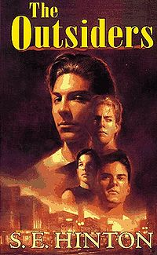
The OUTSIDERS
By Lynn Stege

Slide 2
FACTS
full title · The Outsiders
author · S. E. Hinton
type of work · Novel
genre · Coming-of-age; class struggle
language · English
time and place written · 1960s, Tulsa, Oklahoma
date of first publication · 1967
publisher · The Viking Press
narrator · Ponyboy Curtis
point of view · Ponyboy gives a first-person, subjective account of events, explaining how we should interpret events and people in the story.
tone · Youthful; melodramatic; slangy; simplistic
tense · Past
setting (time) · Mid-1960s
setting (place) · Tulsa, Oklahoma
protagonist · Ponyboy
major conflict · Against the background of the clash between the poor greasers and the rich Socs, the greaser Ponyboy struggles to mature.

Slide 3
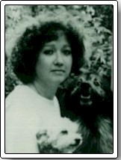
AUTHOR
S usan Eloise Hinton was born in the 1950s in Tulsa, Oklahoma, a place that she describes as “a pleasant place to live if you don’t want to do anything.” She began The Outsiders at the age of fifteen, inspired by her frustration with the social divisions in her high school and the lack of realistic fiction for high school readers. The Outsiders, first published in 1967, tells the story of class conflict between the greasers, a group of low-class youths, and the Socs (short for Socials), a group of privileged rich kids who live on the wealthy West Side of town. The novel broke ground in the genre of Young Adult fiction, transcending established boundaries in its portrayal of violence, class conflict, and prejudice

Slide 4
More on S.E. Hinton S.E. Hinton, was and still is, one of the most popular and best known writers of young adult fiction. Her books have been taught in some schools, and banned from others. Her novels changed the way people look at young adult literature.
“I was fifteen when I began The Outsiders. There was no internet. There were no research sources besides the library. I made up some names I liked with no hidden agenda. But people are always reading things into The Outsiders that I never thought of. Not that that's a bad thing.”

Slide 5
What was it like in the 60’s?
Average Salary $4,743
Teacher's Salary $5,174
Minimum Wage $1.00
Life Expectancy: Males 66.6 years, Females 73.1 years
1961 - Peace Corps created by Pres. Kennedy 1963 - Martin Luther King delivers his I have a dream speech 1963 - Pres. John F. Kennedy is assassinated in Dallas, Texas 1963 - Lyndon Johnson becomes President of the United States
The Civil Rights movement made great changes in society in the 1960's.
1968 – Martin Luther King was assassinated in Memphis, Tennessee

Slide 6
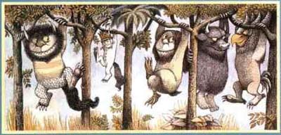
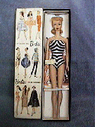
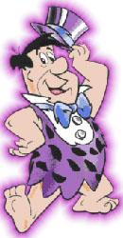
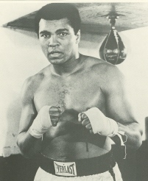
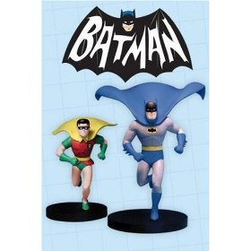
Barbie dolls, introduced by Mattel in 1959, became a huge success in the sixties
1963, Maurice Sendak published Where the Wild Things Are
Flinstones 1960
Alvin & the Chipmunks ‘61
Jetsons 1962
Adams Family 1964
Star Trek 1966
Batman 1966
1960 Muhammed Ali won Olympic GOLD

Slide 7
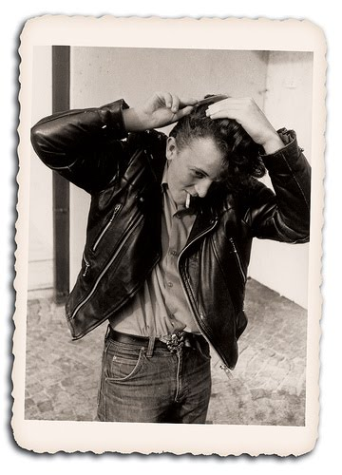
GREASER

Slide 8
GREASERS

Slide 9
Madras shirt
SOC

Slide 10
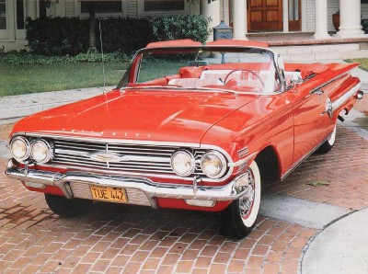
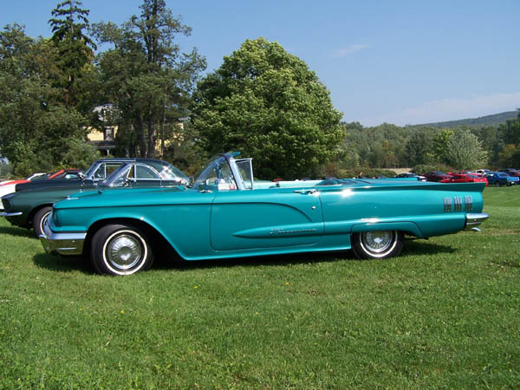
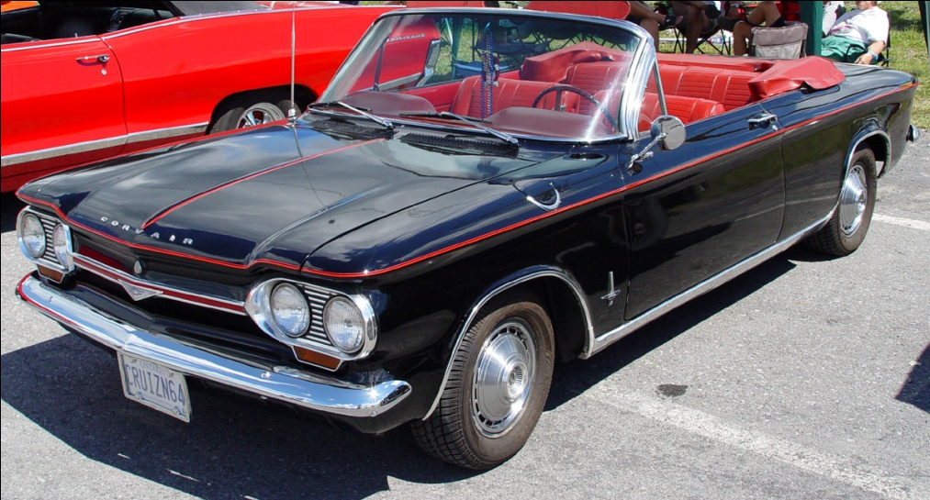
T-BIRD
Corvair

Slide 11
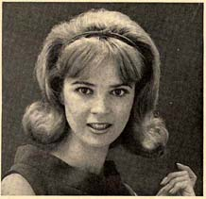
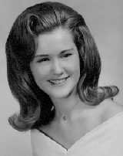
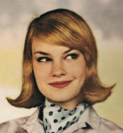
60’s hairstyles

Slide 12
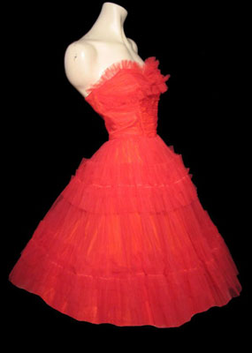
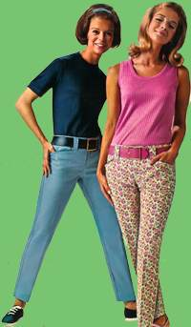
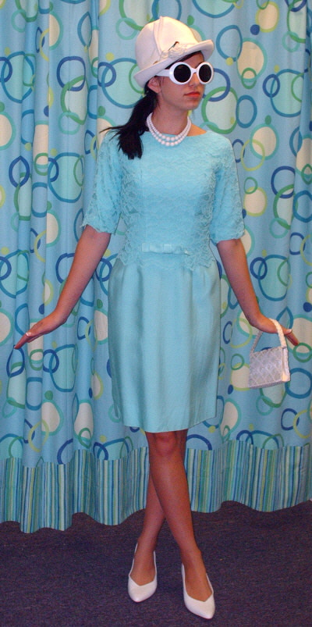
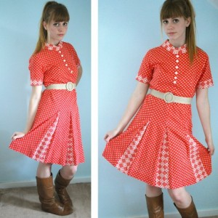
60’s Clothing

Slide 13
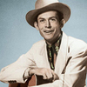
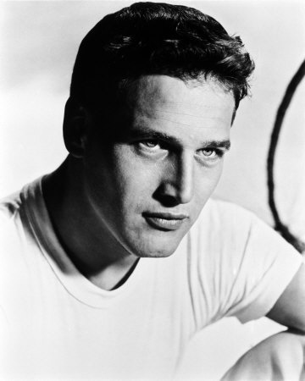
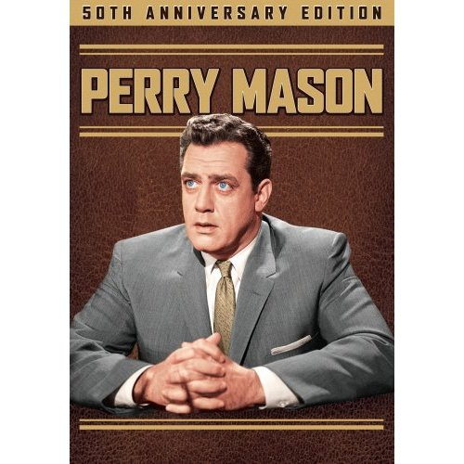
Hank Williams
Paul Newman

Slide 14
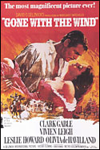
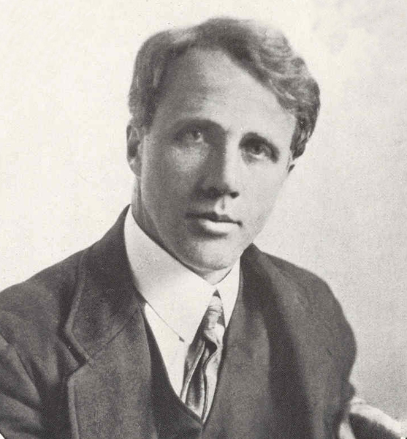
NOTHING GOLD CAN STAY
Robert Frost

Slide 15
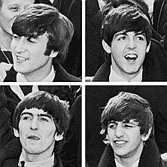
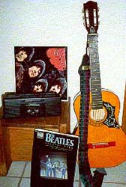
60’s MUSIC
The Twist
Beatles
Sherry
Click the guitar to see the video.
Loco-Motion
Johnny angel
Lion Sleeps Tonight

Slide 16
60’s slang
rumble
Greasers
Socs/Socials
The fuzz
booze hound
Heater
pickled
soused
weed/cancer stick
The cooler
corn poney
JD
Snooker
savvy
tuff
Big Fight
Poor kids from East side-Protagonists
Rich kids from West side – Antagonists
Police
A Drinker
Gun
Drunk
Drunk
Cigarette
Jail
Acting corny/unsophisticated
Juvenile Delinquent
A type of pool game
to understand
cool/sharp

