Slide 1
Can you read this??
I cnduo't bvleiee taht I culod aulaclty uesdtannrd waht I was rdnaieg. Unisg the icndeblire pweor of the hmuan mnid, aocdcrnig to rseecrah at Cmabrigde Uinervtisy, it dseno't mttaer in waht oderr the lterets in a wrod are, the olny irpoamtnt tihng is taht the frsit and lsat ltteer be in the rhgit pclae. The rset can be a taotl mses and you can sitll raed it whoutit a pboerlm. Tihs is bucseae the huamn mnid deos not raed ervey ltteer by istlef, but the wrod as a wlohe. Aaznmig, huh? Yaeh and I awlyas tghhuot slelinpg was ipmorantt! See if yuor fdreins can raed tihs too.

Slide 2
Tuesday 1/29/19 -Could you read it? -quick review from yesterday -anticipation guide/discuss -pg 202 in text “guide for reading” - “What would you do clip” /discuss -pro/con list for being highly intelligent
Flowers For Algernon

Slide 3
What Would You Do? John Quinones ABC News
https://www.youtube.com/watch?v=B2rNcs27Dpg
**discuss word choice in video clip before watching

Slide 4
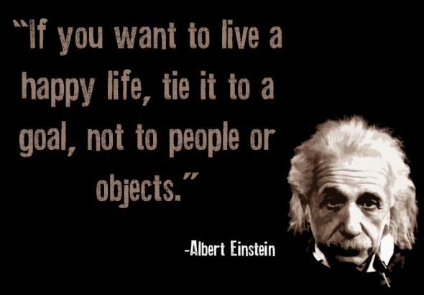
What are the pros for being highly intelligent?
What are the cons for being highly intelligent?

