Slide 1
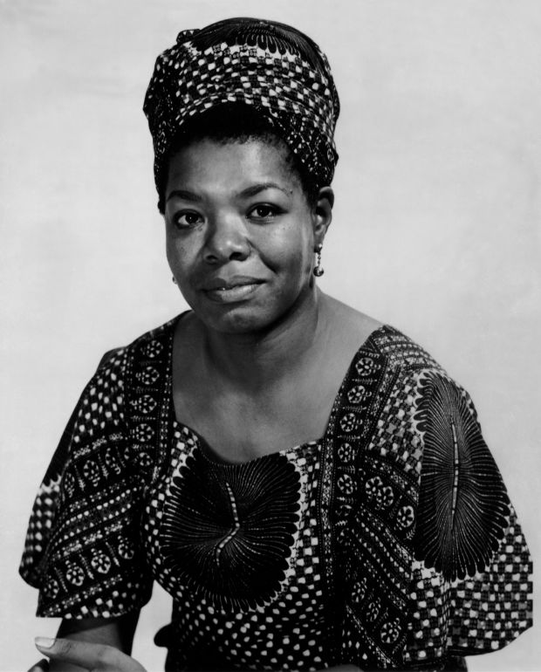
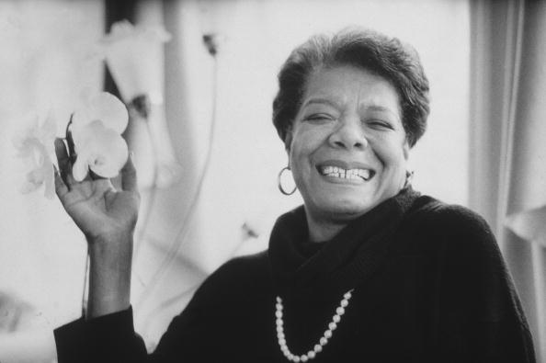
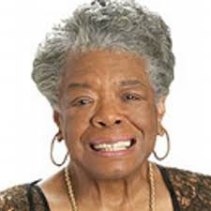
Maya Angelou
3/3/2016

Slide 2
What do you know about Maya Angelou?
What do you already know about Maya Angelou?
Have any of you seen Tyler Perry’s Family Reunion?
Cicely Tyson and Maya Angelou read one of her poems together during the movie

Slide 3
Historical Context
Born in St. Louis, MO and raised there and in Stamps, AR
Lived in Arkansas during the1930s- 1940s and experienced racial and gender discrimination in many situations.
Stamps

Slide 4
Marguerite Johnson (Maya Angelou)
She lived from April 4, 1928 to May 28, 2014 and died at the age of 86.
Her brother gave her the nickname Maya, and she took the name Maya Angelou when she became a singer
She is extremely hard to classify, she is an author, poet, a civil rights activist, an actress, a singer, and a dancer
Read her poem “On the Pulse of Morning” for President Bill Clinton
Awarded Presidential Medal of Freedom in 2010by President Obama.

Slide 5
I Know Why the Caged Bird Sings
Written account about true, important experiences she had in her life and how she overcame them
The story was first publish in 1970, and was a huge success
Produced as a television special in 1979

Slide 6
Inspiration for I Know Why the Caged Bird Sings
Maya had a traumatic experience as a young girl and refused to speak for a while
Mrs. Flowers encouraged her to write her thoughts down
I Know Why the Caged Bird Sings is the first of a collection of five memoirs

Slide 7
What is a memoir?
"A memoir is a form of autobiographical writing- true writing from a person's own life that deals with the writer's memory of someone or of a significant event. In this excerpt from I Know Why the Caged Bird Sings, Angelou writes about her memories of working in the family store...” (p. 23, of Literature: Timeless Voices, Timeless Themes, 2000)
How is a memoir different from autobiography? (Discussion while we transition to text)
https://www.youtube.com/watch?v=QC_scsKVEHA

Slide 8
Inspirational Closing Video
https://www.youtube.com/watch?v=cbecKv2xR14
Dr. Maya Angelou Discusses how love liberates

