Slide 1
Lesson 20 Word Parts
Roots
graph, gram, scrip, scrib

Slide 2
Root words Meaning Words you know
graph, gram write, writing autograph, telegram
scrip, scrib write, writing script,scribble

Slide 3
AUTOBIOGRAPHY
(noun)-an account of one’s own life
His autobiography told only about the complimentary parts of his life.

Slide 4
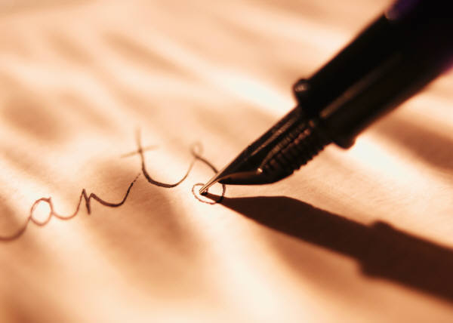
CALLIGRAPHY
(noun)-beautiful, fancy writing
She practiced her calligraphy until she could make each letter perfectly.

Slide 5
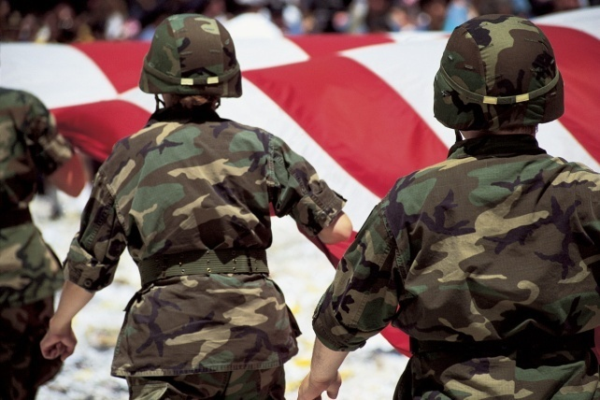
CONSCRIPT
(verb)-to force into service or labor for government
The government conscripted all men between ages of 18 and 25 to be in the army.

Slide 6
EPIGRAM
(noun)-a short, witty poem; a witty, clever saying
His speech was spiced with epigrams that kept the audience entertained.

Slide 7
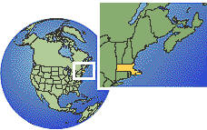
GEOGRAPHY
(noun)-science dealing with the earth’s surface and its features
The geography of the area included mountains, plateaus, and valleys.

Slide 8
GRAPHIC
(adj)-providing a clear picture; vivid and realistic; written or drawn
The author’s graphic description of the setting made you feel like you were really there.

Slide 9
INSCRIPTION
(noun)-something that is written or engraved, especially on a solid surface
The inscription on the gravestone was barely readable because it was so old.

Slide 10

MONOGRAPH
(noun)-a book or article about a single subject
The scientist’s monograph covers his research on cell division.

Slide 11
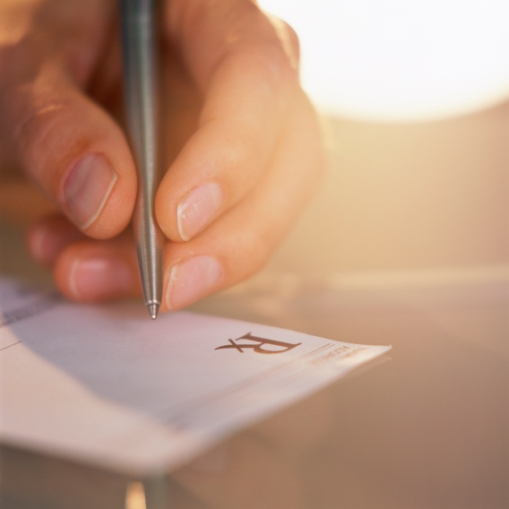
PRESCRIPTION
(noun)-an order or direction; a doctor’s instructions for the use of medicine
The prescription said to take the medication three times a day.

Slide 12

TRANSCRIPT
(noun)-a written or typewritten copy
The executive asked her secretary to make a transcript of the notes on the meeting.

Slide 13
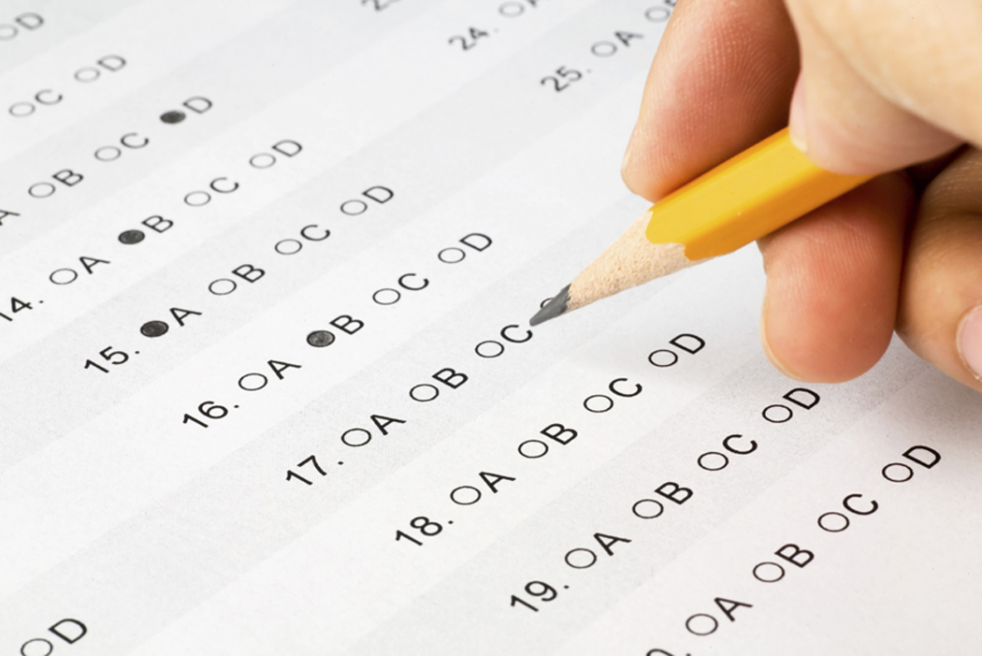
NOW PRACTICE YOUR WORDS…
GOOD LUCK!!
DON’T FORGET-QUIZ THIS FRIDAY!!

