Slide 1
Advertising
The Role in American Culture 2016

Slide 2
Advertisements
What are advertisements? Talk with a partner and prepare to share out the definition you come up with.
What are some media options for where advertising can be found?
In your groups, list details about commercials
and ads you remember, including product
Choose one of those ads you remember:
Write the medium
Who the intended audience is and why
The purpose of the advertisement

Slide 3
Advertisements: Reasons
Teens view more than 40,000 ads on T.V. alone
What are some reasons you think teens are targeted for ads? TPS
Have money to spend
Want newest “luxury” items
Have time
What teenage issues and stresses do advertisements use? TPS
Peer acceptance
Body image
Peer pressure

Slide 4
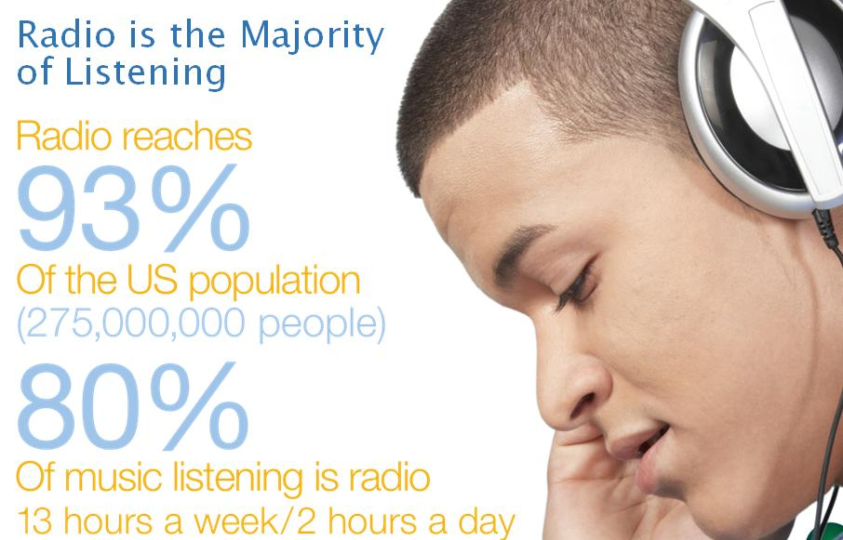
Types of Appeals: Logos, Pathos, Ethos
Logos is an appeal to logic or reason
Includes evidence and statistics
Pathos is a strategy that attempts to evoke an emotional response
Ethos is a strategy that appeals to credibility or character

Slide 5
Types of Techniques Used in Advertising
Bandwagon
Bait and Switch
Celebrity
Emotional Appeals
Plain Folk
Shows ordinary people using or supporting
Feel certain emotions
Famous person endorses product
False promise of a bargain
“Everybody else does”

Slide 6
Types of Techniques Used in Advertising
Glittering Generalities
Humor
Loaded Language
Name-Calling
Individuality
Attacks people or groups to discredit ideas
Uses highly valued beliefs like patriotism, peace, or freedom
Makes audience laugh, but provides little info
Appeals to desire to be different
Positive or negative connotation (purr, snarl)

Slide 7
Let’s Analyze this Advertisement:
What is the message?
What persuasive technique(s)?
* Bandwagon
* Bait and Switch
* Celebrity Spokesperson
* Emotional Appeal
* Glittering Generalities
* Humor
* Individuality
* Loaded Language
*Name-calling
* Plain Folk
* Product Comparison
Who is the target audience?
Is the ad effective? Explain.

Slide 8
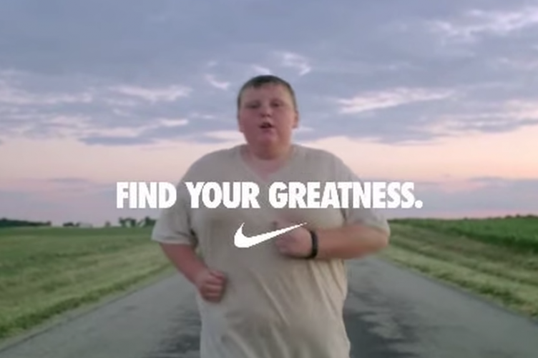
In your groups: analyze and answer the four questions
What is the message?
What persuasive technique(s)?
Who is the target audience?
Is it effective? Explain.
Bandwagon
Bait and Switch
Celebrity Spokesperson
Emotional Appeals
Glittering Generalities
Humor
Individuality
Loaded Language
Name-calling
Plain Folk
Product Comparisons

Slide 9
Analyze the Commercials
http://www.tubechop.com/watch/7678259
http://www.tubechop.com/watch/7678269
http://www.tubechop.com/watch/7678411
http://www.tubechop.com/watch/7678424

Slide 10
Your group will analyze one of the following:
DL Skechers Burst
WG Skecher Shape-Ups
Gatorade Always Wins
Axe Effect
Kleenex
NW Nike
Your group will answer the following questions:
1. What is the message?
2. What persuasive technique(s) does the advertisement use?
3. Who is the target audience? (gender and age group)
4. Is it effective? Explain.

Slide 11
Print Advertisements

Slide 12
Print Advertisements

Slide 13
Print Advertisements

Slide 14
Advertising Assignment
Any Questions?
What will you advertise?
You will be expected to use at least three of these advertising techniques to create an advertisement of your own.
You will create a (school appropriate) advertisement about a product or invention that improves physical, mental, emotional, or psychological well-being.
You can choose your format of media.

